Slide 1
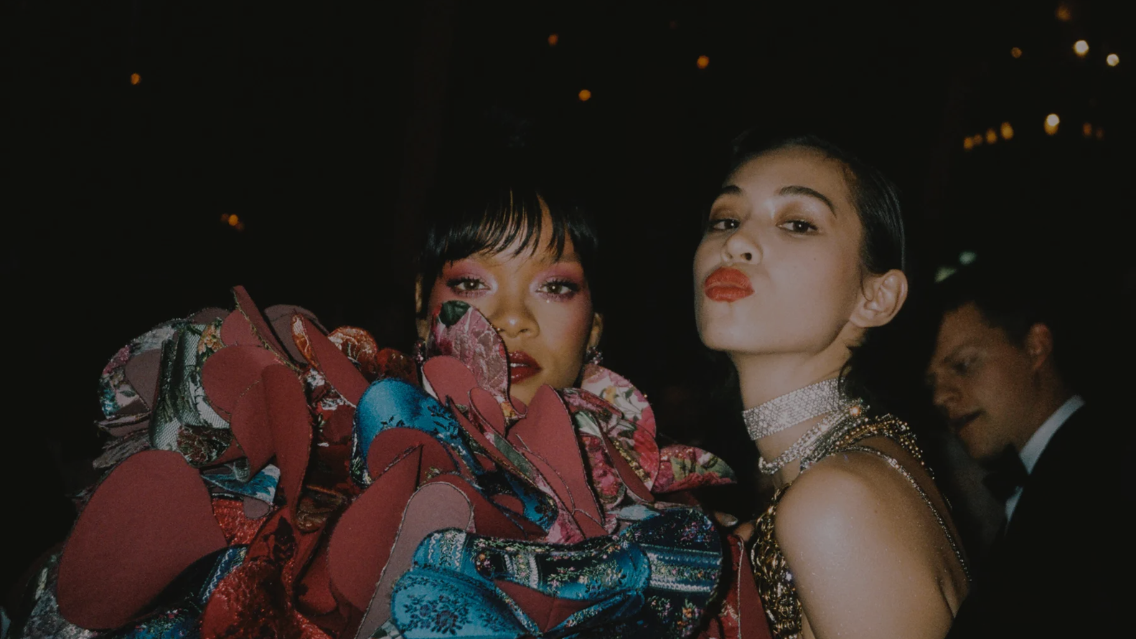
Pouring luxury into gifting
Don Julio 1942 design brief

Slide 2
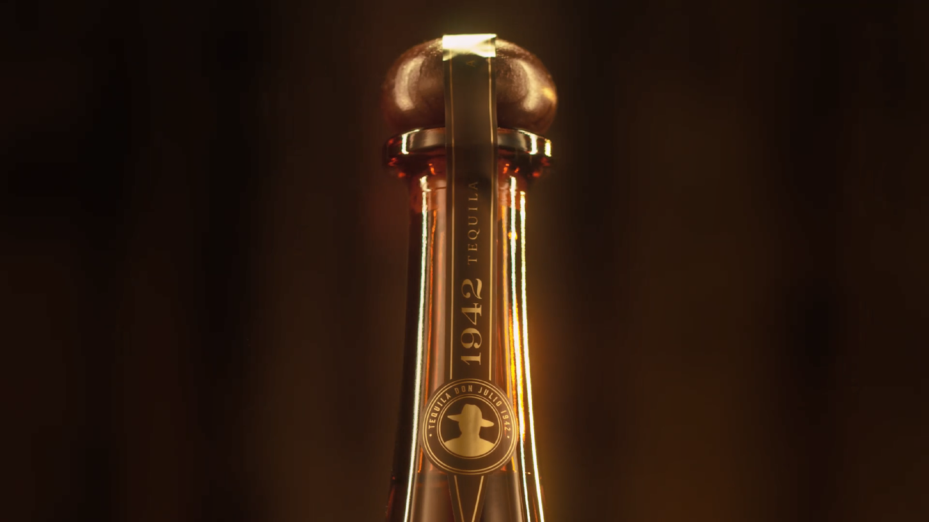
BORN FOR MONUMENTAL CELEBRATIONS
Crafted in celebration of Don Julio Gonzalez’s 60th birthday, 1942 was made for the most monumental of celebrations. More than just a name, 1942 is the year our founder began his journey to create the world’s most luxurious tequila.
A MONUMENTAL BOTTLE
Our globally iconic bottle is our most visual expression of monumental. Like the luxury icon that it is, 1942 speaks simply and powerfully to people through scale and verticality and is the pinnacle of the spirits experience.
A MONUMENTAL LIQUID
Our globally iconic bottle is our most visual expression of monumental. Like the luxury icon that it is, 1942 speaks simply and powerfully to people through scale and reach.

Slide 3
MONUMENTAL CELEBRATIONS
ALWAYS HIGH IN STYLE, OUR OCCASIONS BRING A SENSE OF MONUMENTAL ENERGY.
Never overly manufactured.
Exclusive yet sociable. Aspirational but always authentic.
We are not limited to epic milestones.
We are the moments that capture a life well-lived, shared amongst our beautiful tribe of fellow magnetic tastemakers.
We consider the ‘how’ and the ‘who’ above the ‘what’ and the ‘why’

Slide 4
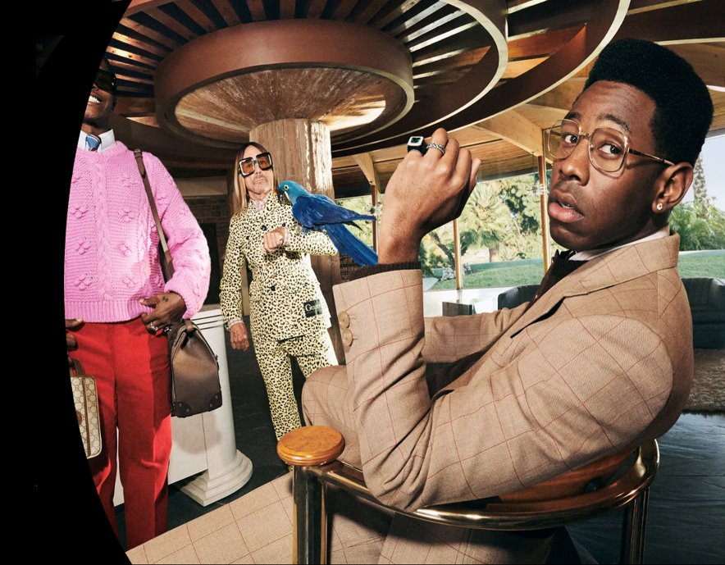
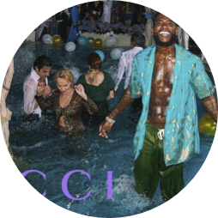
OUR CONSUMER
THE INFLUENTIALS
Our target is dynamic and consistently seeking out what’s new or unique. They enjoy being early adopters, prefer quality over quantity, and they set their own trends.

Slide 5
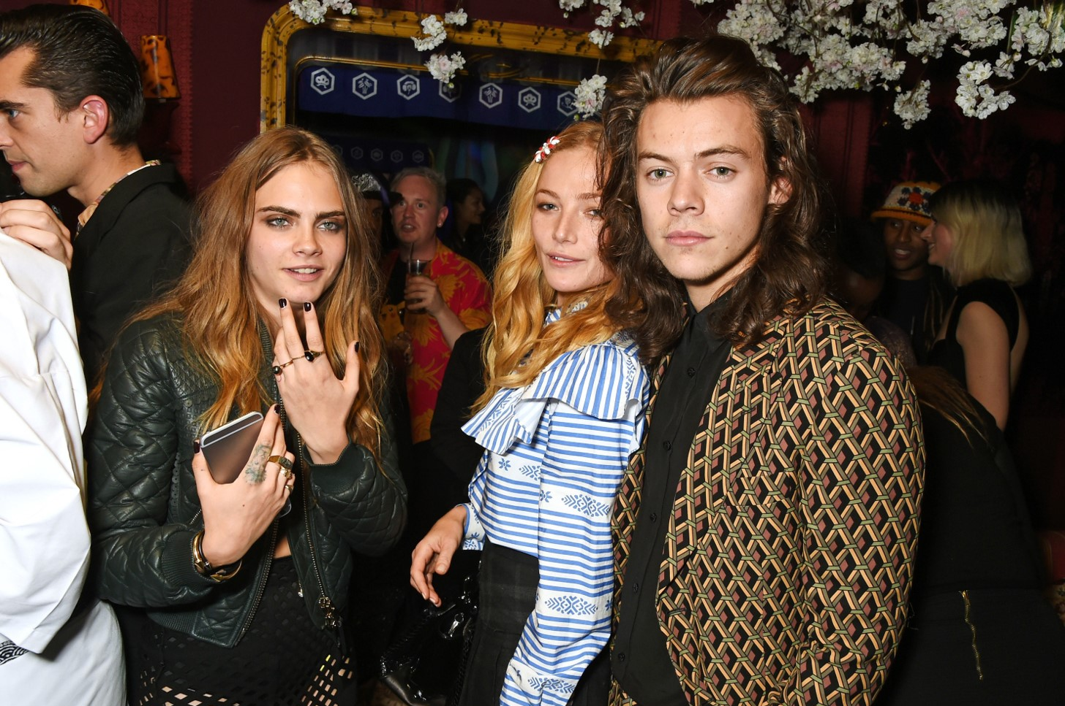
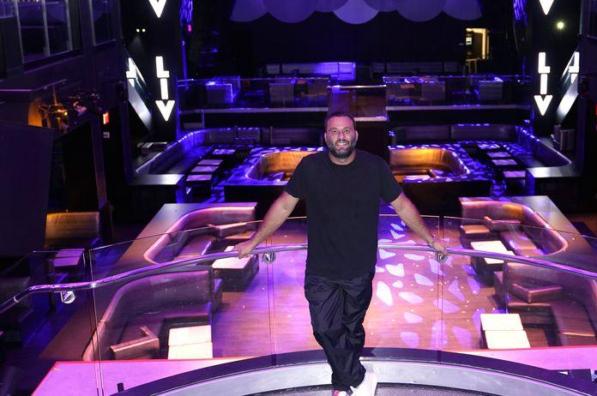
THEY ARE…
ON THE WORLD STAGE
BEHIND THE SCENES
CURATORS OF LUXURY EXPERIENCES
Notable household names
Musicians, DJs, models, presenters, broadcasters. Producers, Directors. Designers, Artists, Dancers. Notable industry & public figures
The experts who support the big names
Agents, Managers, Publicists, Assistants, Stylists, Costume Designers, Glam squads, Photographers. A&R/Label reps
Owners of luxury on trade
Restaurant/bar/club owners, promoters, Chefs, bartenders, luxury services (villa owners, party planners, yachts, florists, etc.)

Slide 6
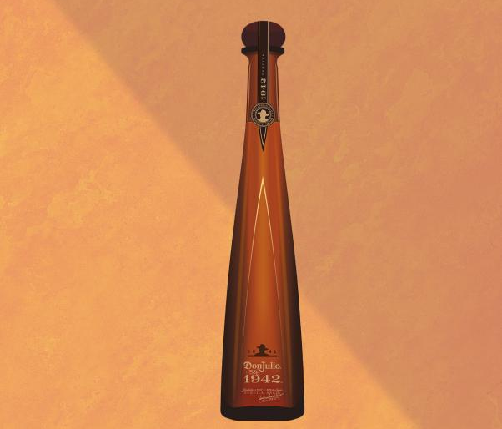
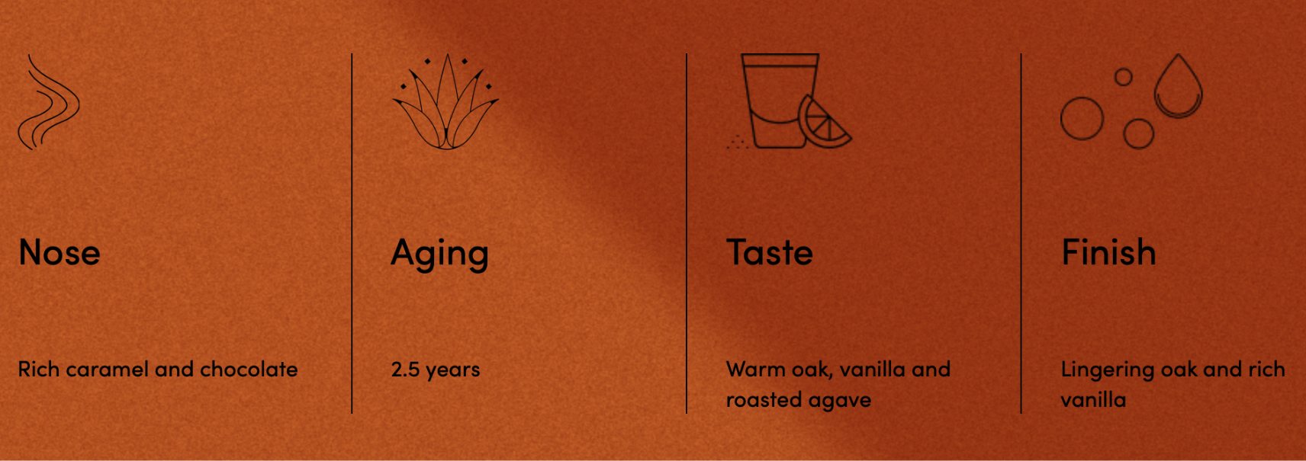
Don Julio 1942
Celebrated in exclusive cocktail bars, restaurants and nightclubs, the iconic Don Julio 1942® Tequila is the choice of connoisseurs around the globe.
Don Julio 1942® Tequila is handcrafted in tribute to the year that Don Julio González began his tequila-making journey.
Produced in small batches and aged for a minimum of two and a half years.
Made from 100% Blue Weber Agave.

Slide 7
The task
Create a unique gift pack design for Don Julio 1942, that goes beyond the generic gift box & gift bag concept, with sustainability in mind.
The content of the packaging design kit is up to you. Any unique accessories, elements or even non-physical, immersive experiences are welcome.
The design should be fresh, extravagant and a true epitome of luxury - but suitable for everyday gifting situations.
Make sure you build on the existing brand cues, while you can play with it, tweak it as long as it’s unmistakably linked to the Don Julio 1942 brand world.
The design can reflect sustainability elements, but the primary focus should be on being iconic and luxurious.

Slide 8
Brand guidelines
Brand universe

Slide 9
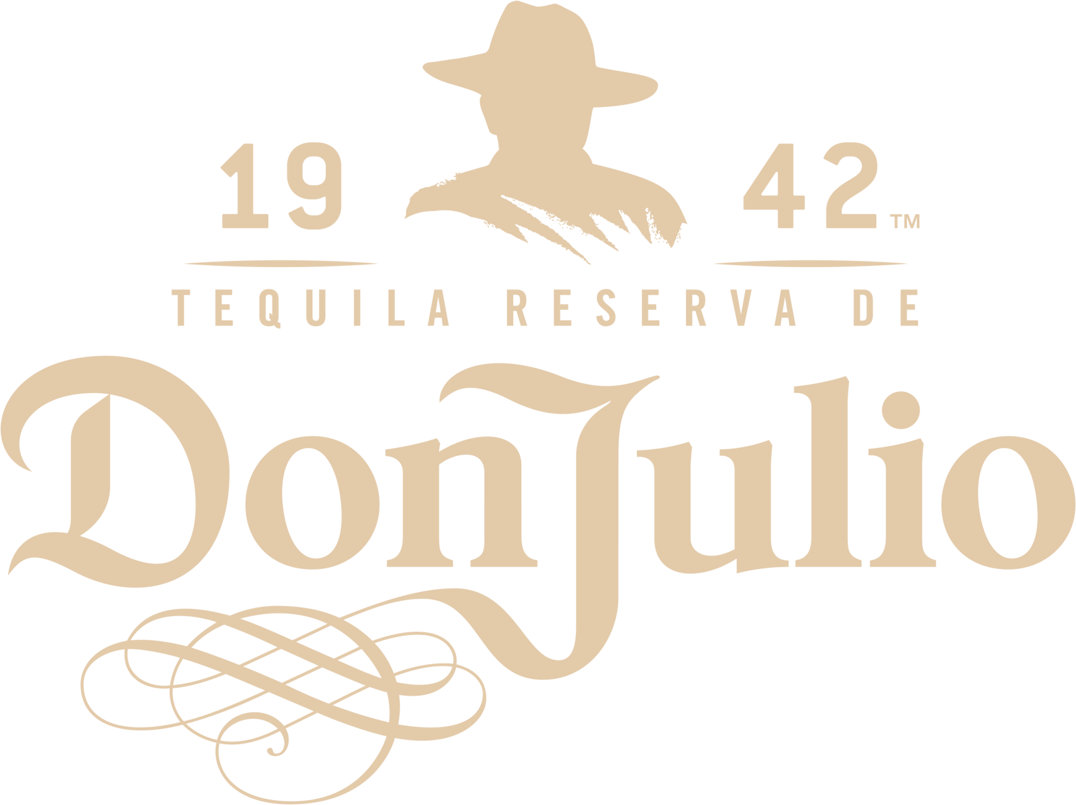
ANALOGFOLK
INTERIM DESIGN GUIDELINES

Slide 10
OUR DESIGN DIRECTION
Stop behaving like a premium alcohol brand Start acting like a luxury global brand.
Be visually bold and brave.
Set trends instead of following them.
Be brand-forward, but treat our KBAs with playful confidence.

Slide 11
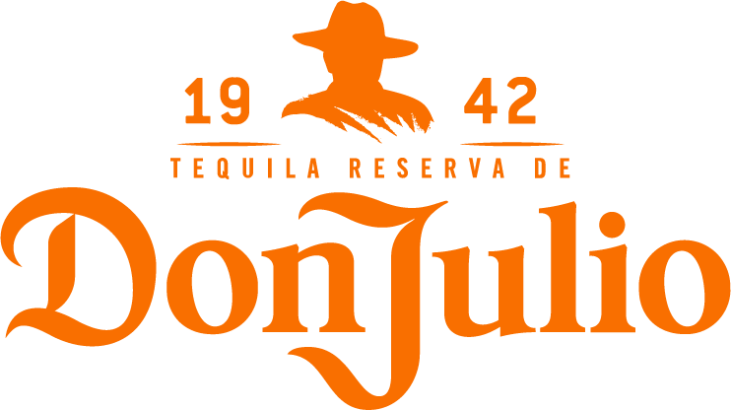
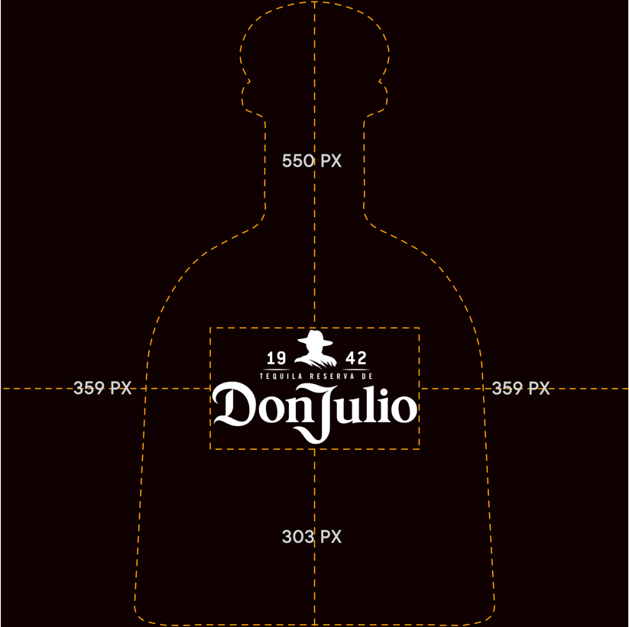
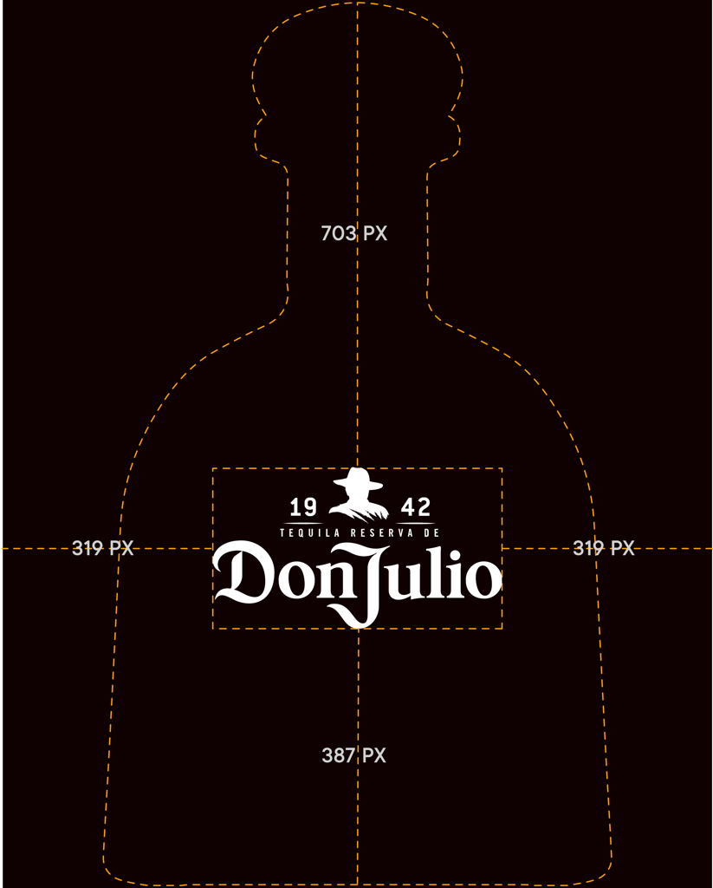
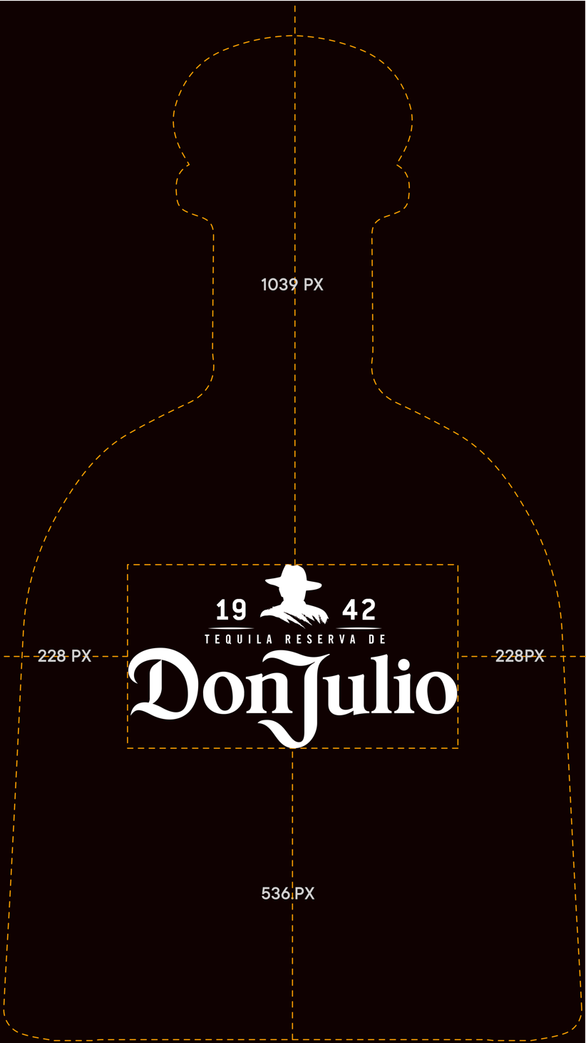
ANALOGFOLK
KBA
Primary logo Position
When we need to clearly distinguish Don Julio from other brands, and if the job to be done is recognition, we use the Primary logo in it’s original form to make sure it’s easily and instantly recognizable.
The size and position of the primary logo used for social formats is dictated by the Don Julio bottle and label position. When scaled to maximum height or width of the social format the logo size and position is determined.
Using this method works well for each format size. It helps with consistency across the social channel but also becomes an ownable position within each asset that is unique to Don Julio.

Slide 12
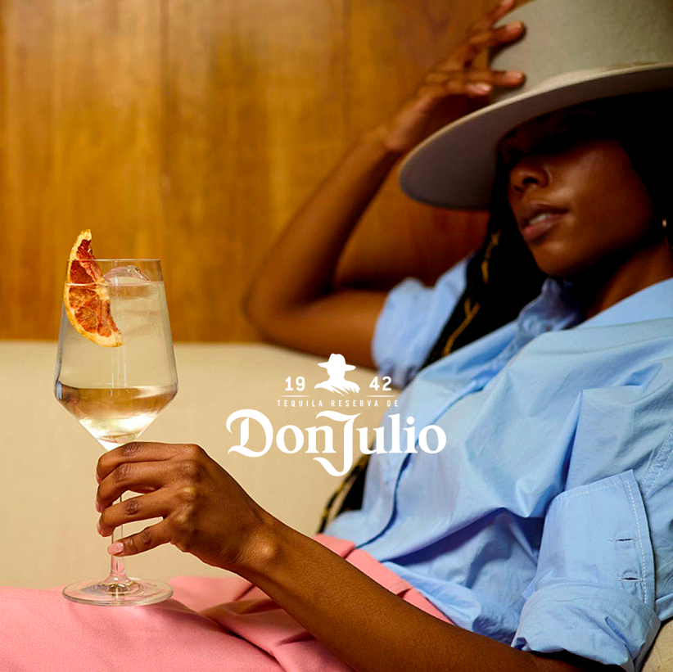
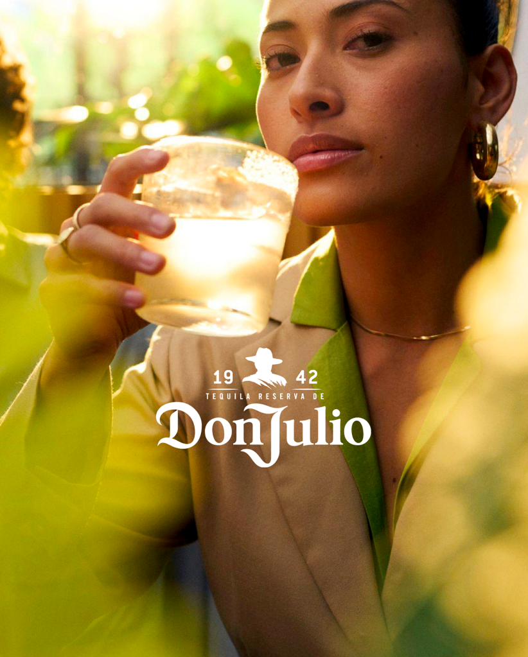
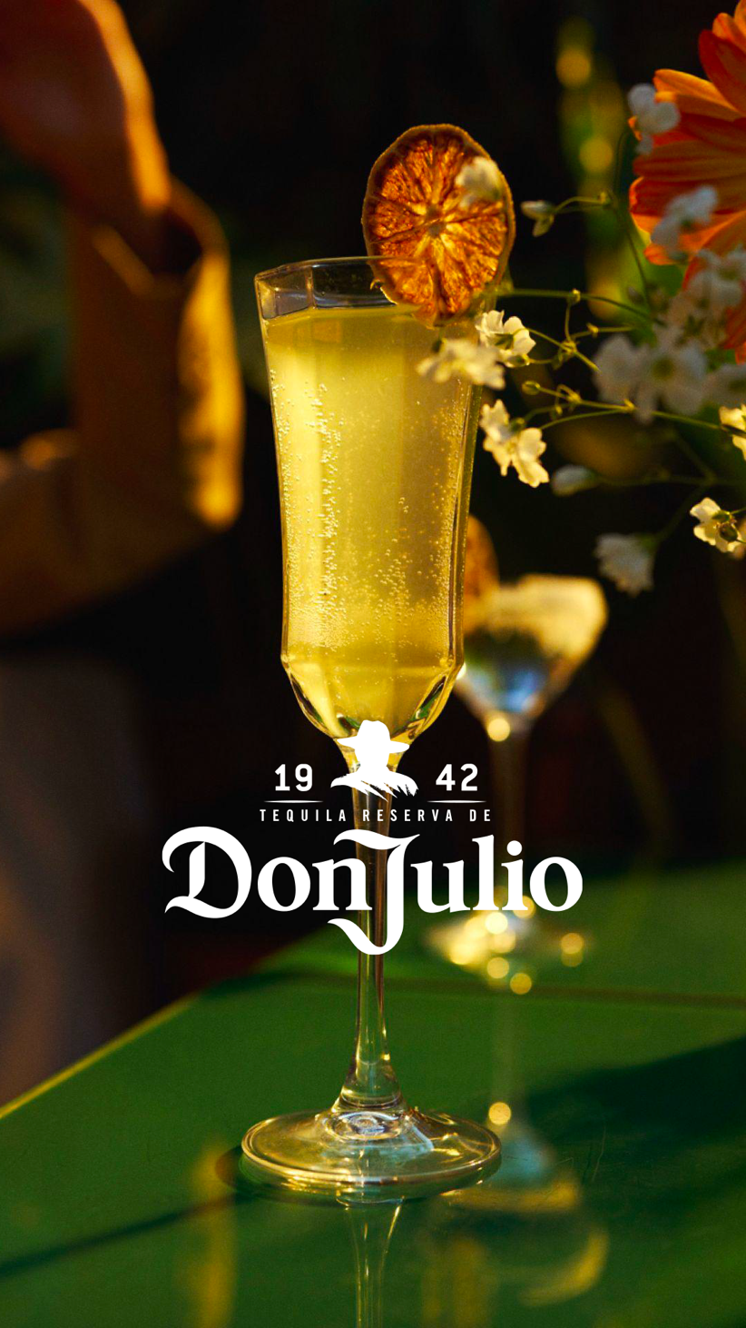
ANALOGFOLK
KBA
Primary logo position examples.
Terms of use.
Do not use if a Don Julio logo is already present in the first frame of the social post.
Only to be applied to paid social assets.

Slide 13
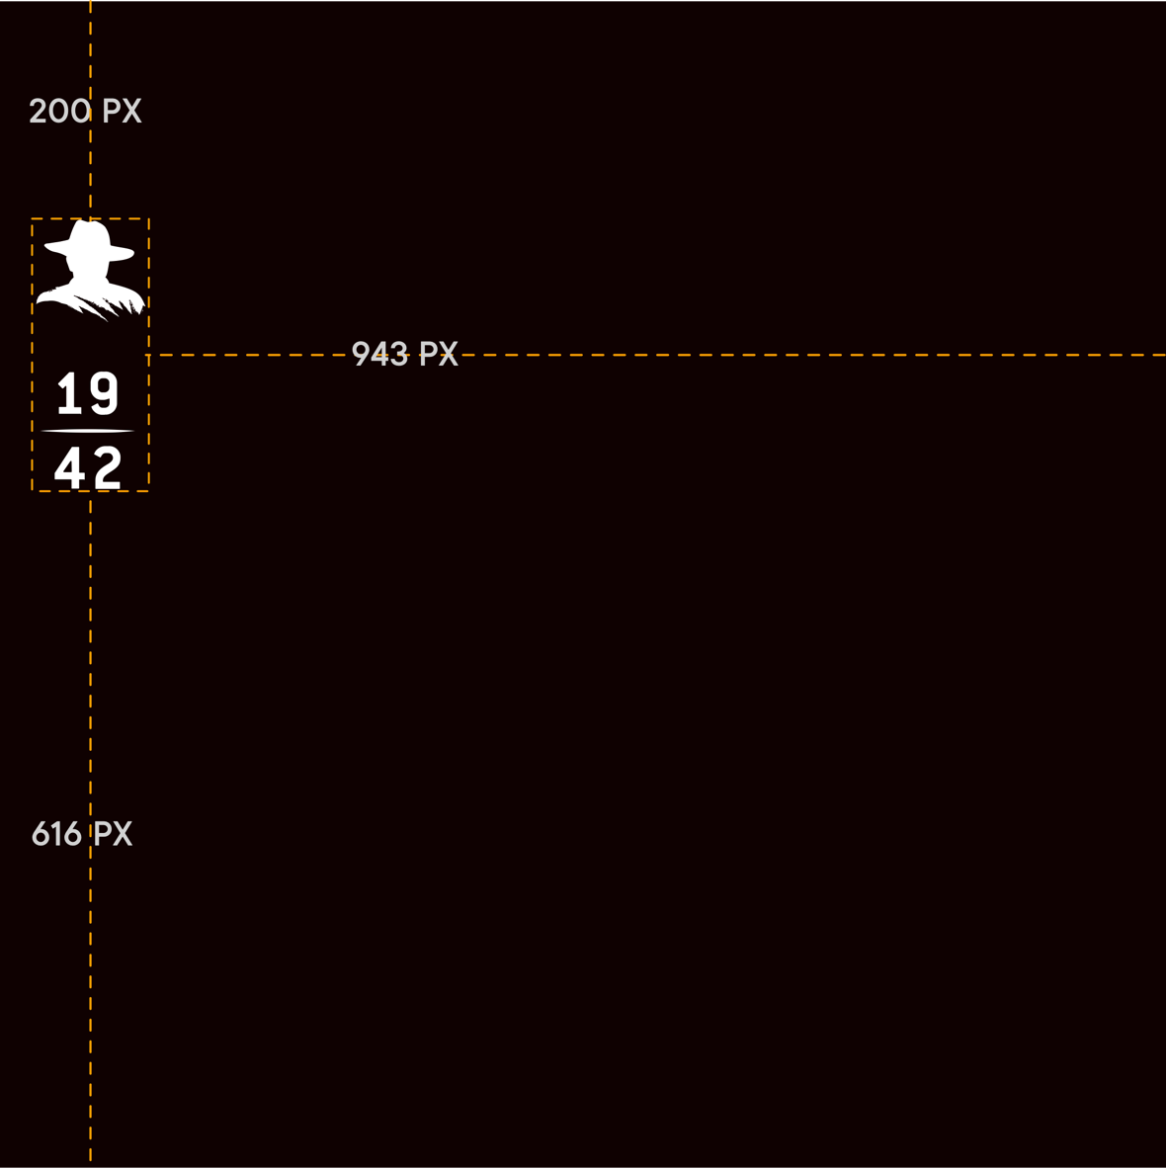
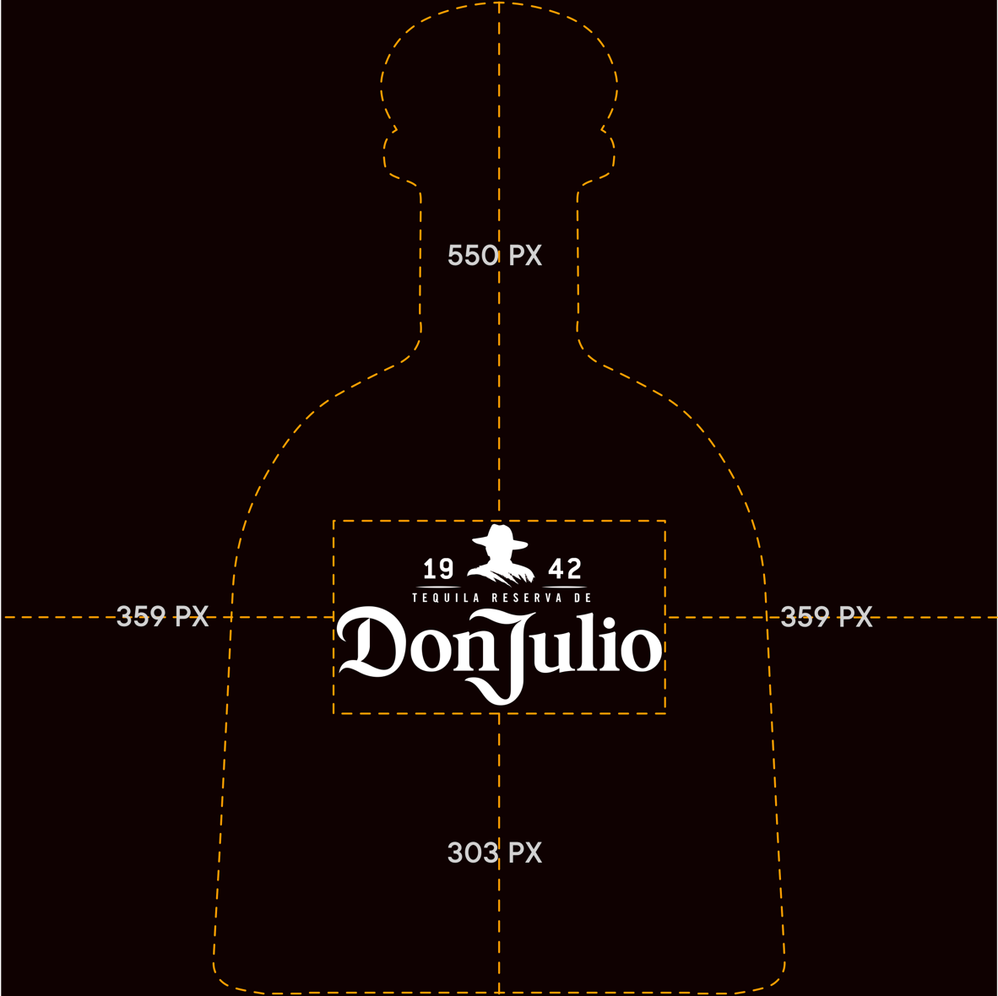
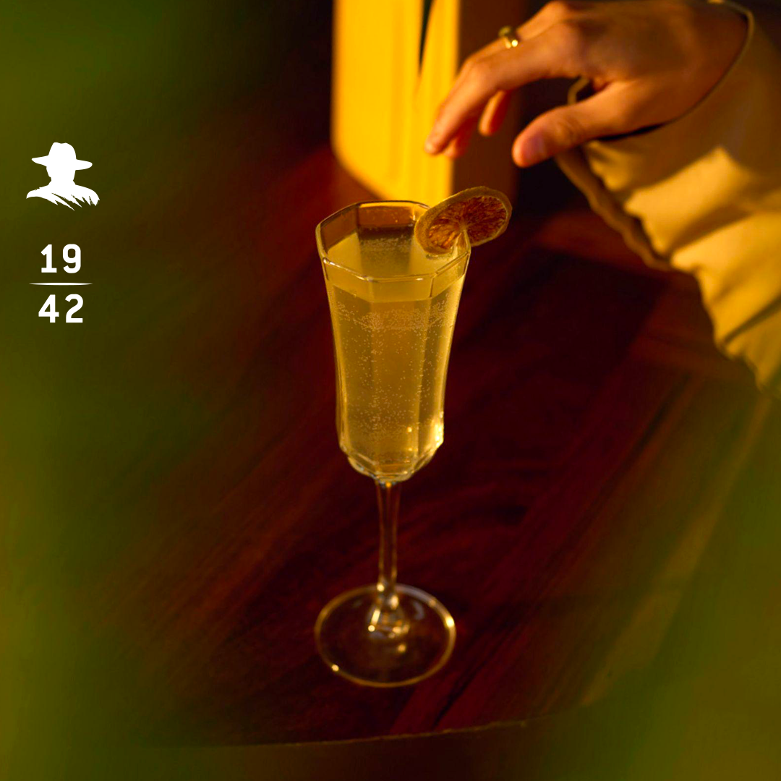
ANALOGFOLK
KBA
1942 Man with hat vertical stack 1:1
The 1942 man with the hat KBA can be applied to organic posts when further brand recognition is needed.
Terms of use.
Only to be used on images that have enough contrast so the KBA can be clearly seen.
100 PX
250 PX

Slide 14
ANALOGFOLK
KBA Crop
The primary logo KBA crop has been developed and can be used in established markets.
The scale and positioning of the logo brings with it a mark of confidence, strength of brand presence. It gives the asset a unique disruptive attitude, loud and proud of its brand association, feeling modern and unapologetic.

Slide 15
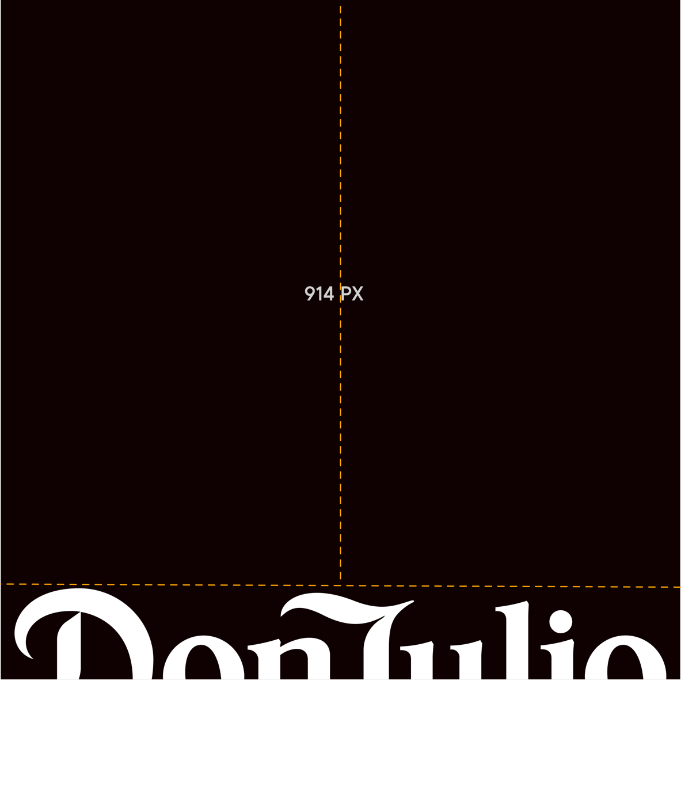
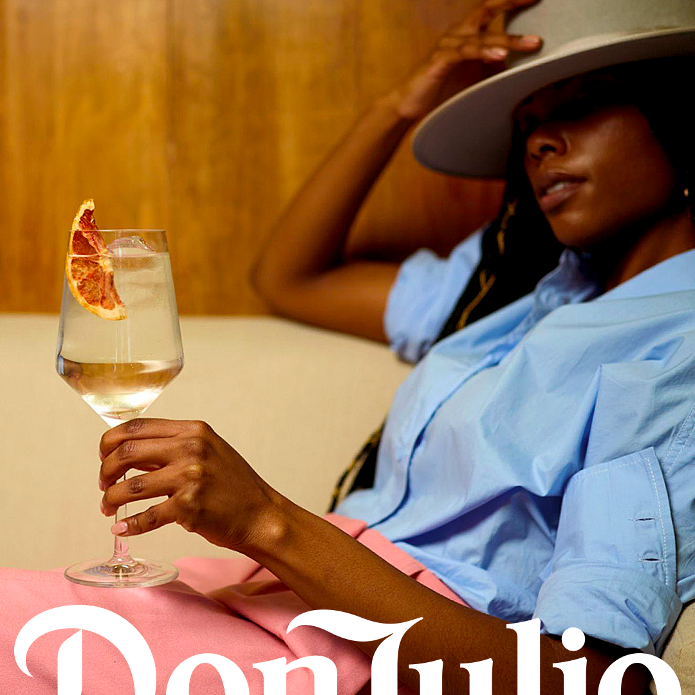
ANALOGFOLK
KBA crop Horizontal 1:1
The primary logo crop can be used to enhance brand recognition for paid social media.
Terms of use
Not to be used in 9:16 formats due to safe zone restrictions
1037 PX
310 PX

Slide 16
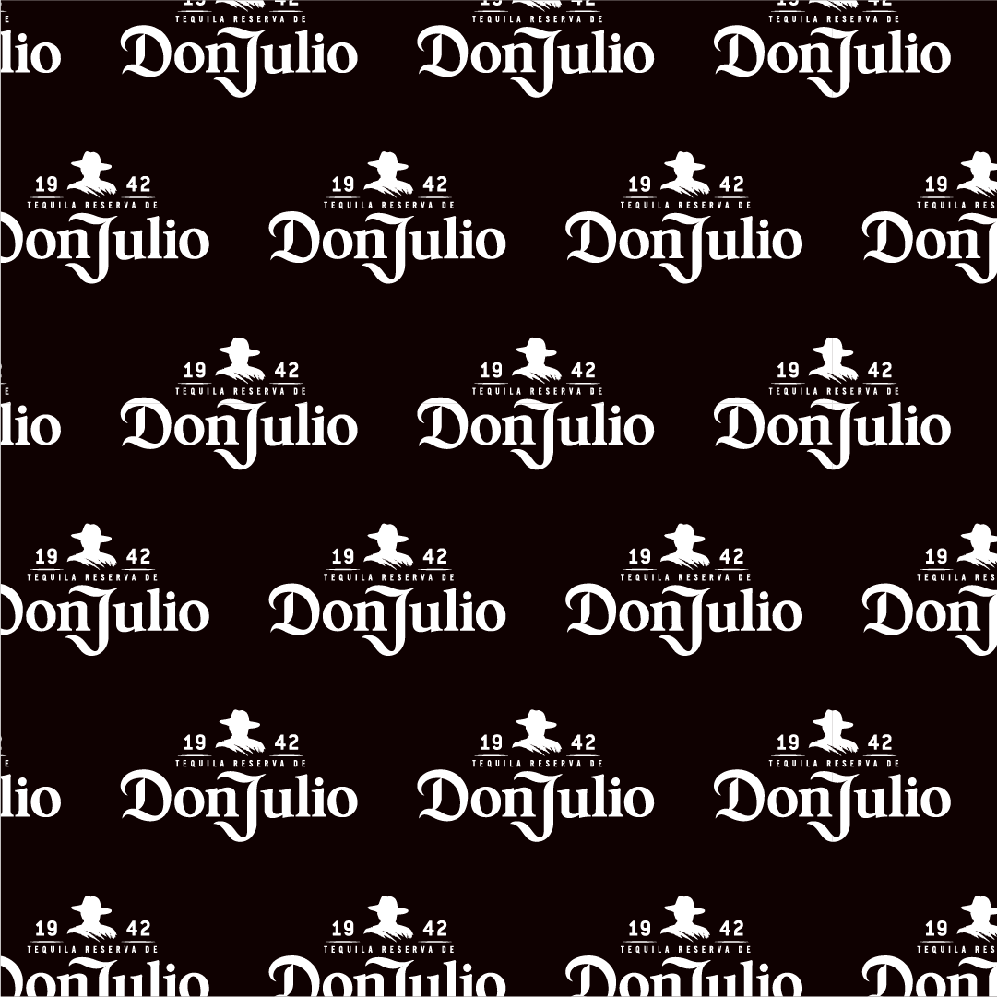
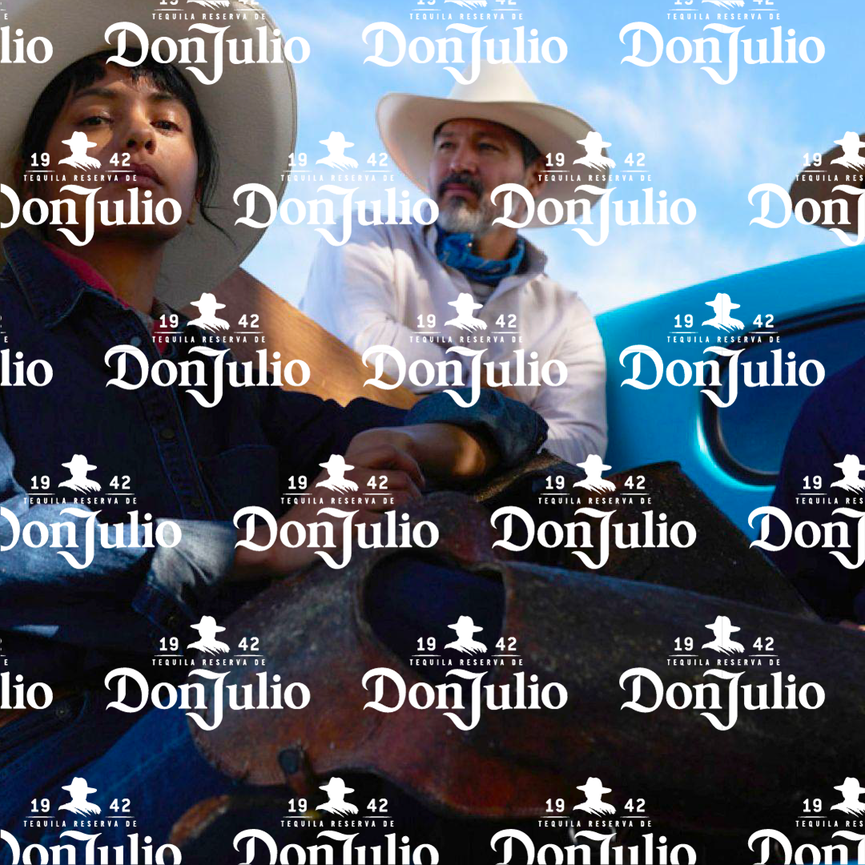
ANALOGFOLK
KBA takeover primary pattern 1:1
The KBA takeover has been developed to be used to enhance brand recognition within animation and motion social sequences and formats.
Disruptive and eye catching it can help to bring energy, attitude and vibrancy to a sequence of still images or motion.
Terms of use
Only to be used in motion sequences

Slide 17
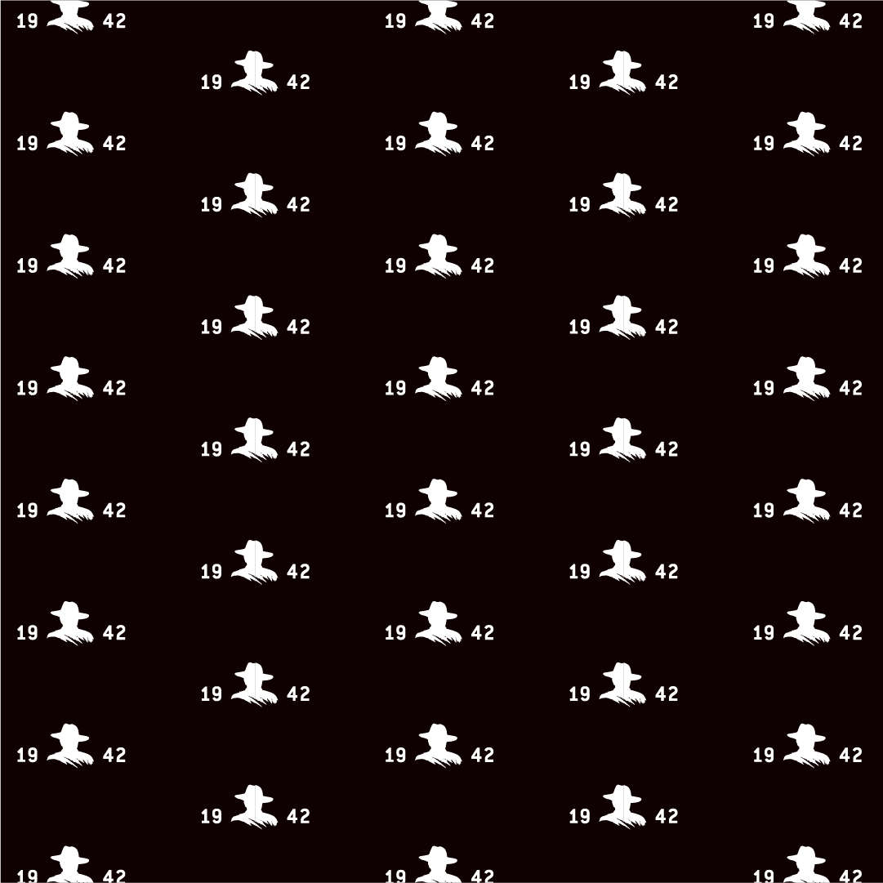
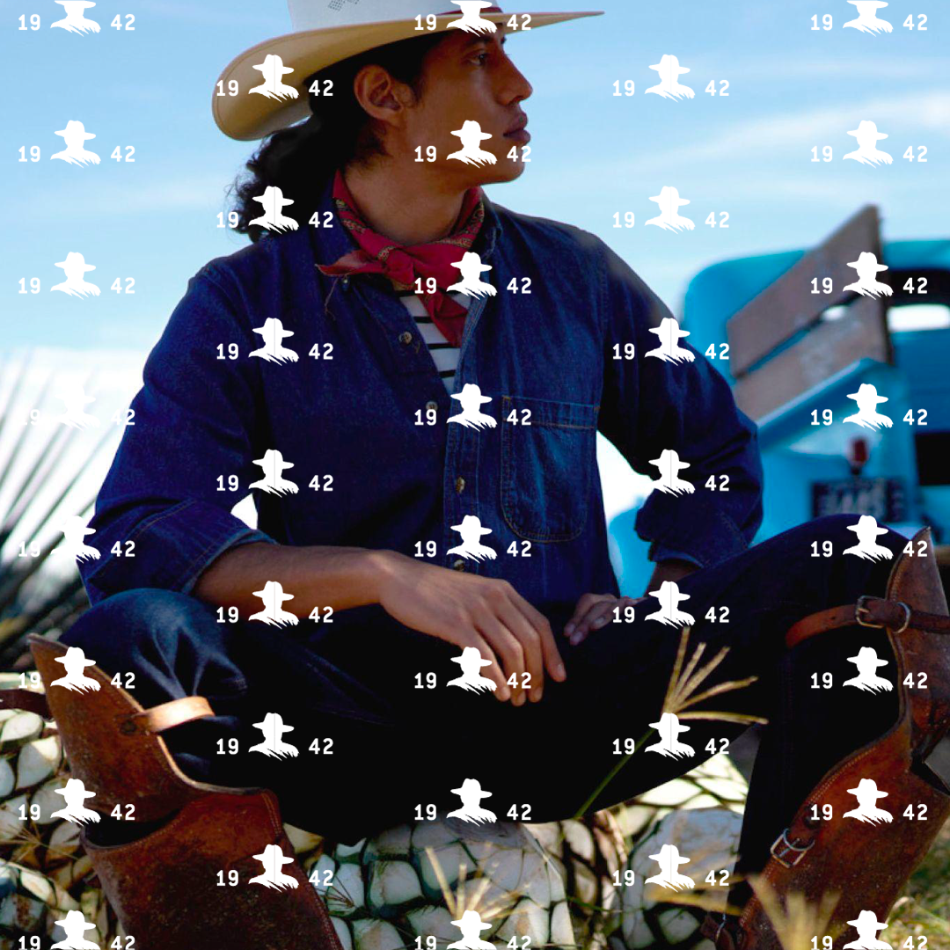
ANALOGFOLK
KBA takeover varient 1942 pattern 1:1
The KBA takeover has been developed to be used to enhance brand recognition within animation and motion social sequences and formats.
Disruptive and eye catching it can help to bring energy, attitude and vibrancy to a sequence of still images or motion.
Terms of use
Only to be used in motion sequences

Slide 18
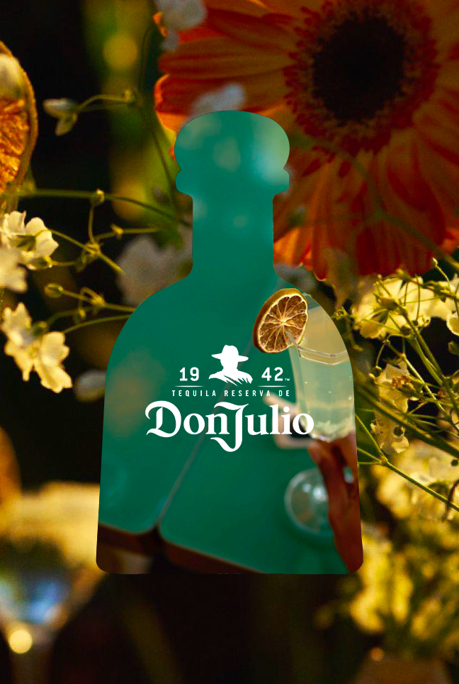
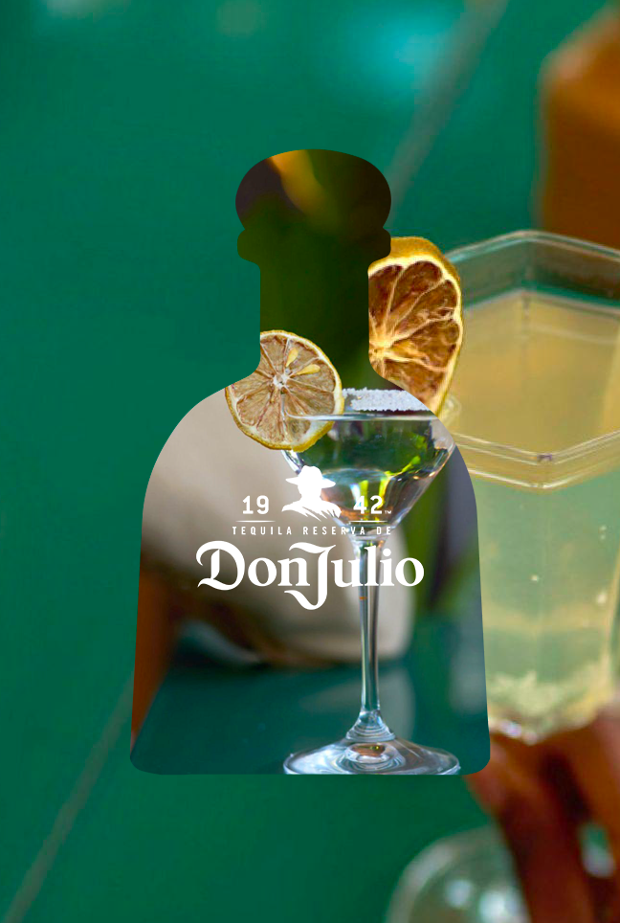
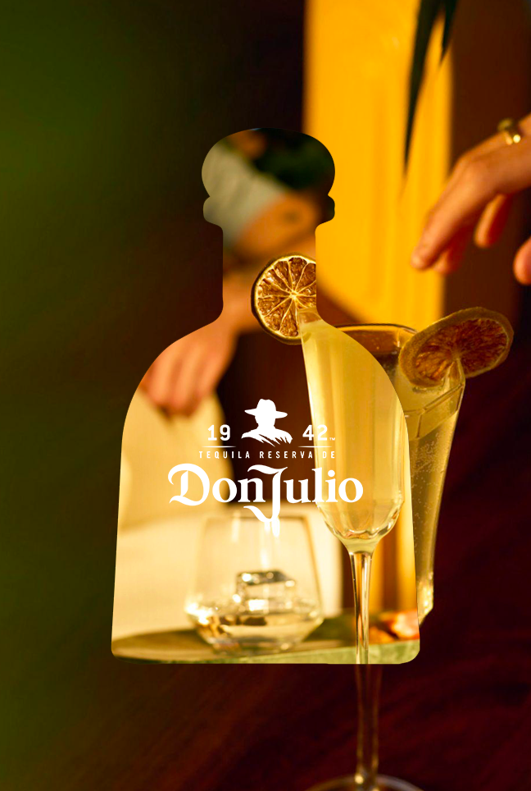
ANALOGFOLK
INTERIM DESIGN GUIDELINES

Slide 19
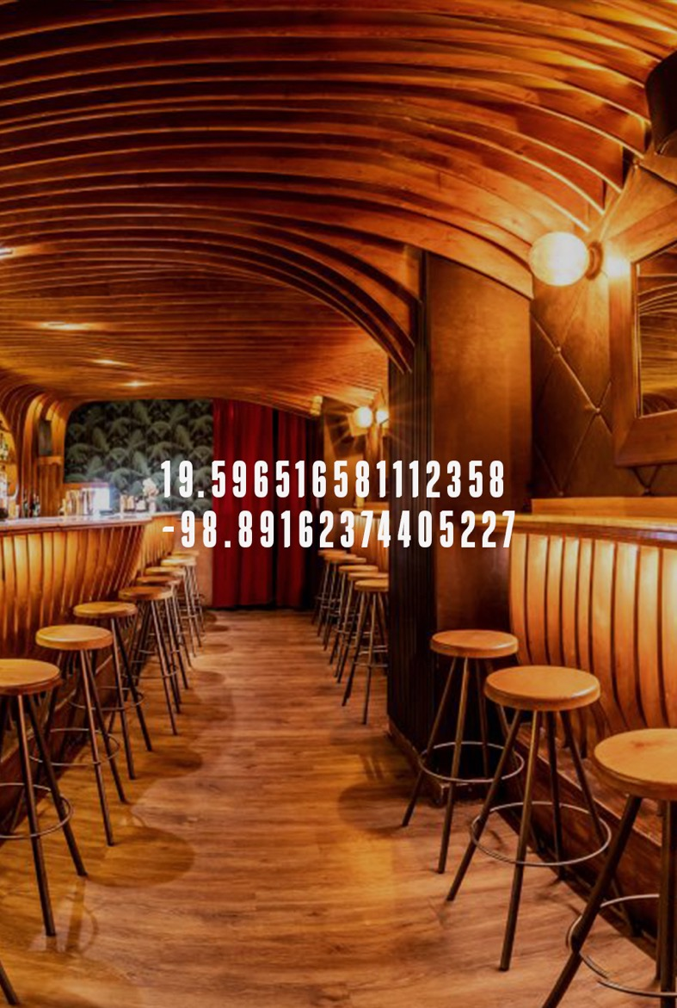
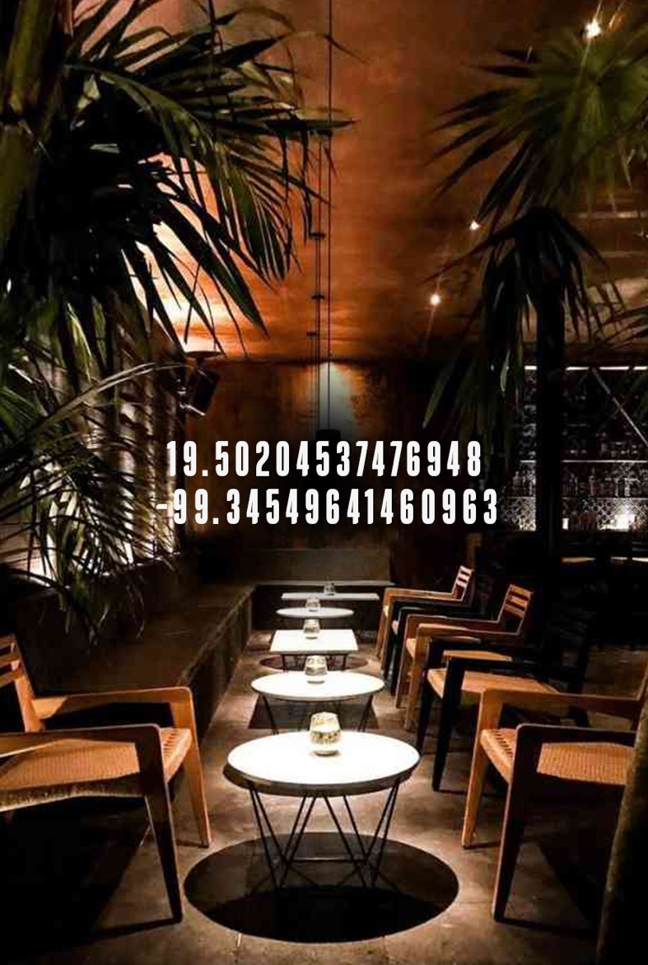
ANALOGFOLK
Typography
The use of type embedded into social posts should only be used when it has a function to communicate its connection to a specific image or helps as a description for an abstract image.
Type layout should be simple yet sophisticated, elegant and function.
The aim to draw the viewer in, not to shout at them.
Try to avoid adding campaign lines within social posts.
Font use in this example
DonJulio-Regular Capitalised.
Font point size in this example
71 Pt
Tracking in this example
120
Line spacing in this example
67 Pt

Slide 20
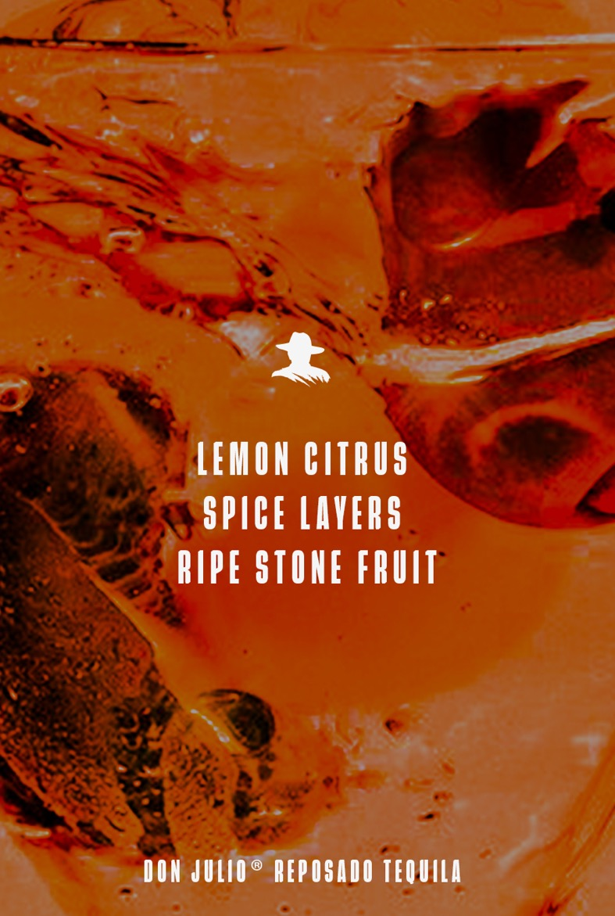
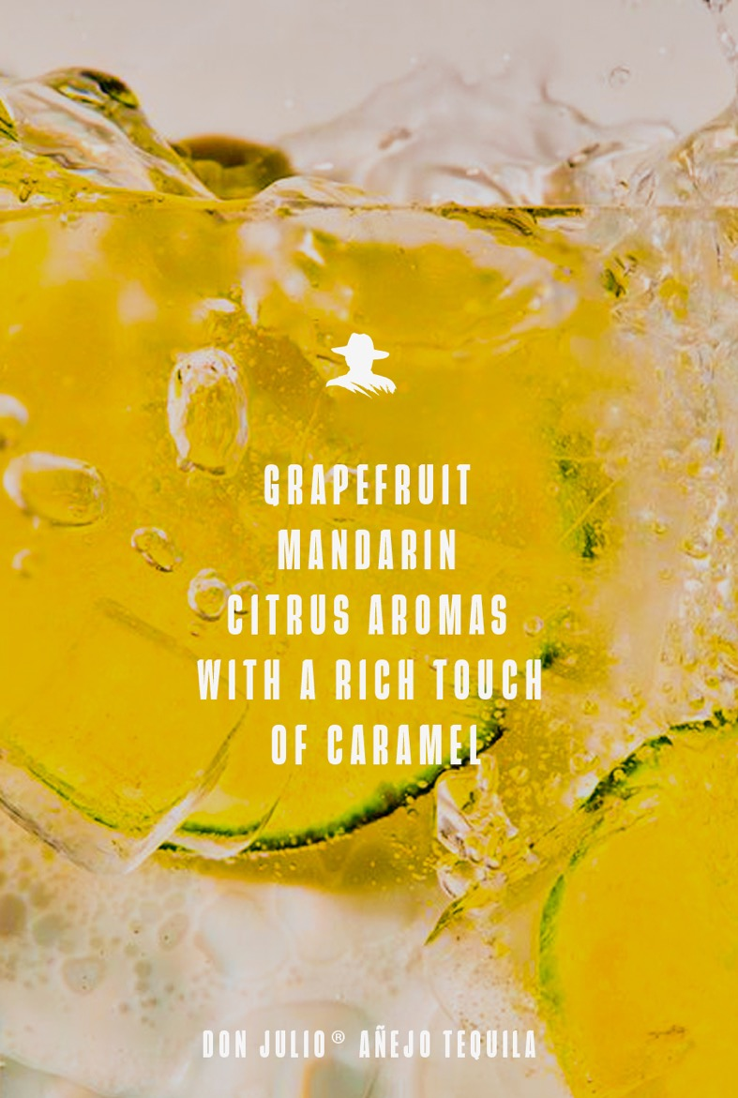
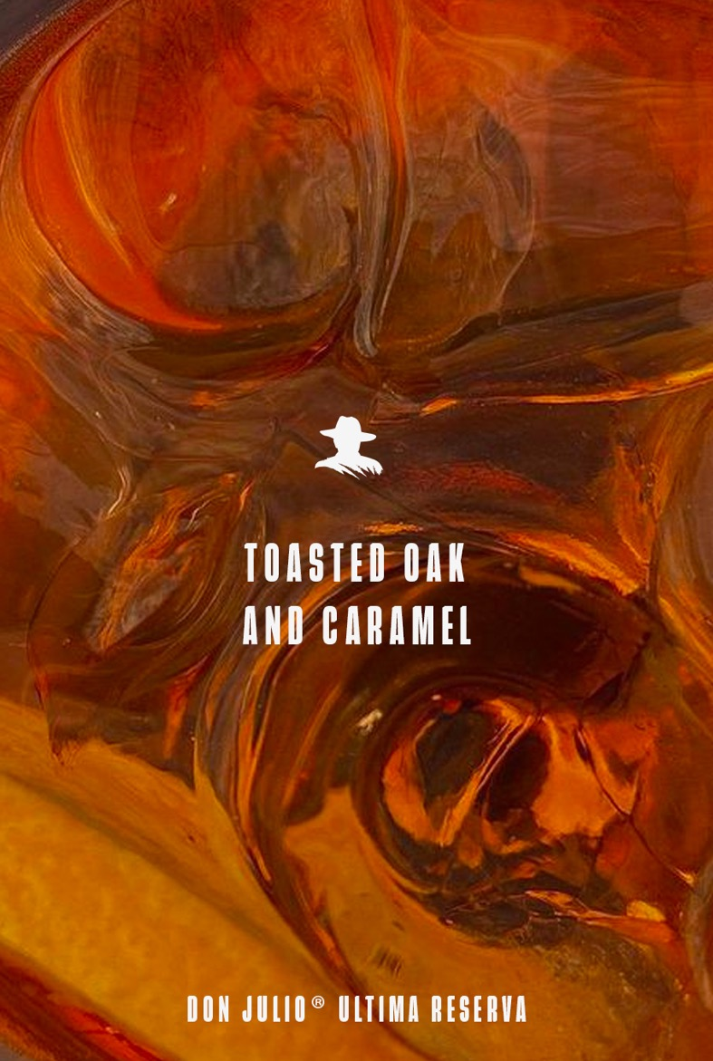
ANALOGFOLK
Typography
The use of type embedded into social posts should only be used when it has a function to communicate its connection to a specific image or helps as a description for an abstract image.
Type layout should be simple yet sophisticated, elegant and function.
The aim to draw the viewer in, not to shout at them.
Try to avoid adding campaign lines within social posts.
Font use in this example
DonJulio-Regular Capitalised.
Font point size in this example
71 Pt
Tracking in this example
120
Line spacing in this example
80 Pt

