Slide 1
Golden Sweet Nectar
Design/Aranysárga team

Slide 2
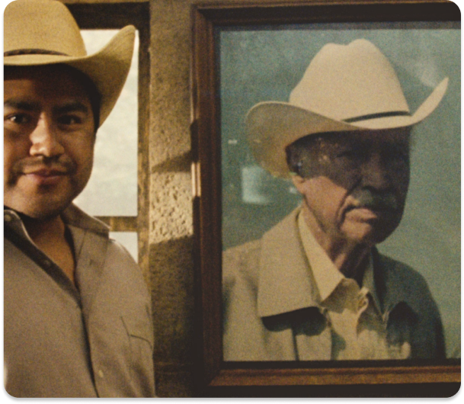
Know no limits
The Don Julio 1942 at the tip of one’s hand is the epitome of a life well-lived. In celebration of its founder, Don Julio Gonzalez, this monumental liquor symbolizes grandiosity and is a call to one’s true self.
With a powerful dream, hard work, and unwavering faith, he created a legacy—and the world’s best tequila.
Much like Don Julio Gonzalez, our clientele have a fiery passion for the finer things in life. They’re trendsetters, go-getters, and the crème de la crème.
And to that, deserving of only the finest.

Slide 3
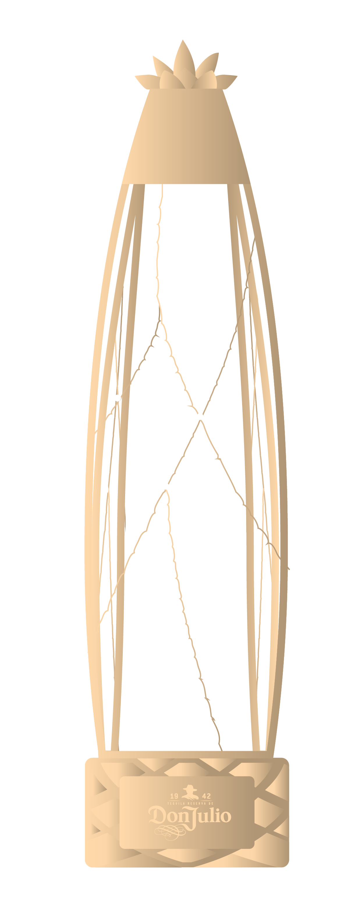
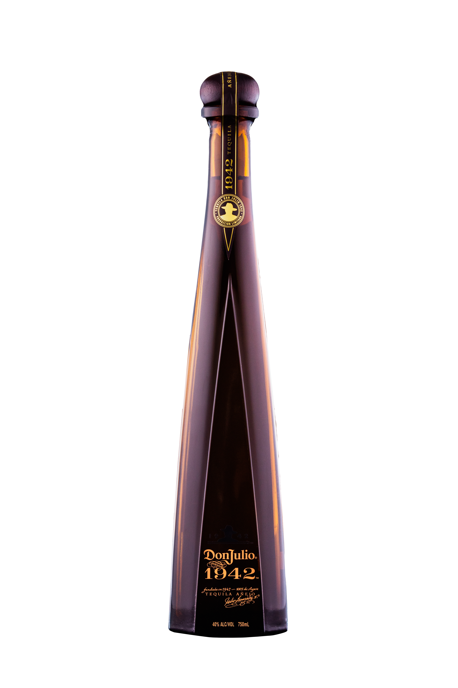
More than just the heart
The sweet agave pinas are the heart of Don Julio 1942.
Surrounding this nectar are the agave leaves that make the agave plant strikingly perceptible. Drawing inspiration from these robust leaves, we created a design that reflects the nature of agave
in its luxurious, more exclusive form.
To realize this vision, we’d collaborate with Swarovski to pick the finest gems that complement the Don Julio 1942 and tell a personal story. Personalized by zodiac signs, colors or stones of choice..

Slide 4
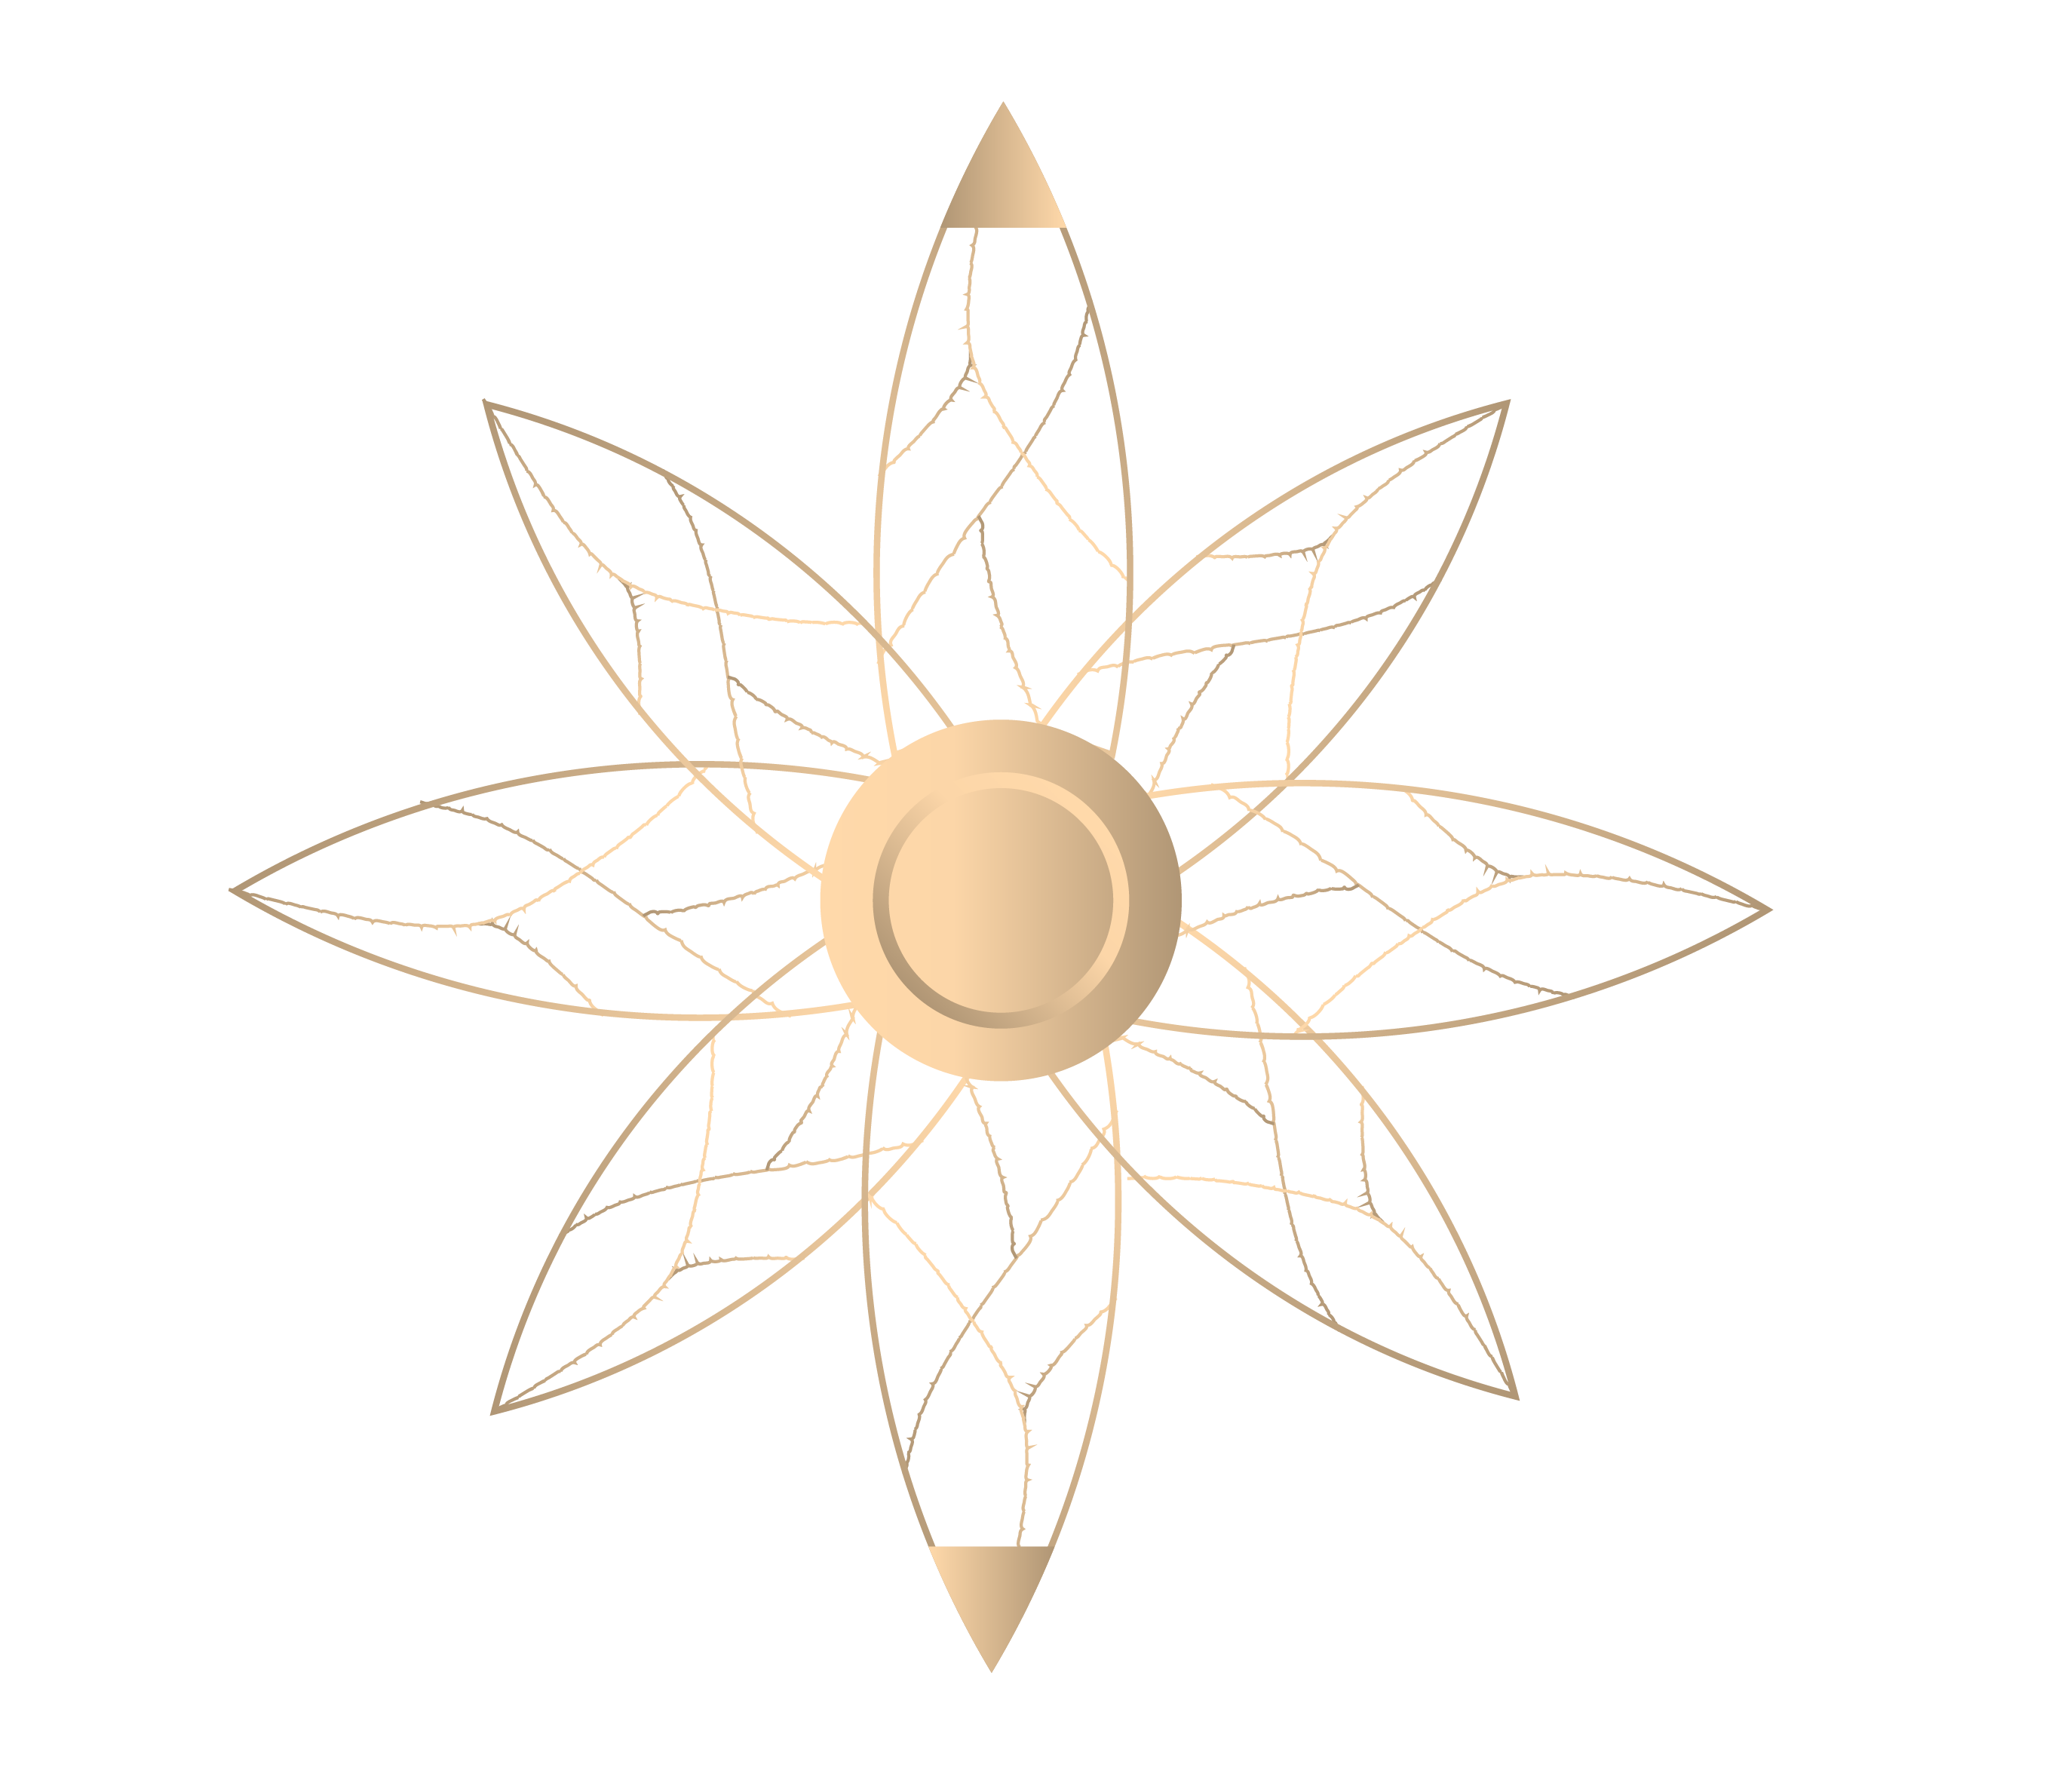
Multisensory indulgence
Step inside a lush multisensory experience of the Don Julio 1942 and let your unique journey begin.
Held by a special magnet at the top and along the edges, when released, the packaging spreads wide open, revealing the Don Julio 1942.
A non-futuristic gift would be incomplete for our elite. To perfectly match the gift recipient's sophisticated lifestyle, a voice-recorded message can play upon opening the package.
Additionally, a handwritten message on agave paper can be included at the top of the bottle to seal the deal.

Slide 5

Enter a world of luxury
The unique gem enclosed in each package is the gateway to even more luxuriousness for the elite.
This gem, our golden sweet nectar, has an embedded NFC that grants our elites access to the most exclusive events and venues.
As if stepping into a portal, this gem is a key or way of entry to private spaces. With it, they can step out of the public eye and into a new world with the power of their unique gem.
Away from the limelight — and into a safe space.
Here, no words are needed. Luxury speaks for itself.
This personalized gem, a bespoke timepiece, could be transformed into a button, cufflink, or ring.

Slide 6

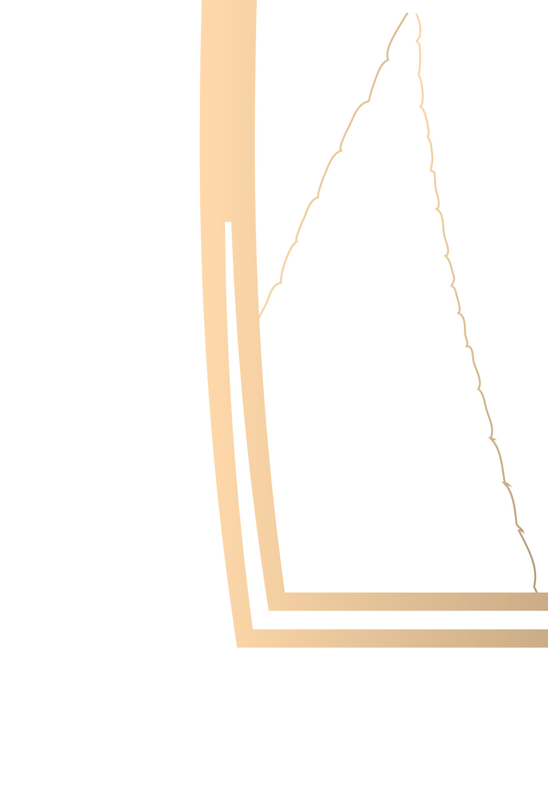
Create your own legacy
Inspired by the great Don Julio Gonzalez, the heart lies at the core of our purpose.
A step closer to the design reveals small intricate details, giving the story its meaning.
With sustainability in mind, neatly woven agave fiber from the plant surrounds the packaging and embodies the ribbed outline of the agave leaves.
Locking the woven agave intersection points
are sparkling Swarovski gems.
The inner petals release the luminous light that glows upon the opening of the packaging—amplifying the sensory experience of the liquor.
All these pieces are held tightly at the bottom of the packaging by the “root.”

Slide 7

From nothing
comes everything
​
What better way to speak their language, than with a luscious liquor that embodies their opulent lifestyle?

Slide 8
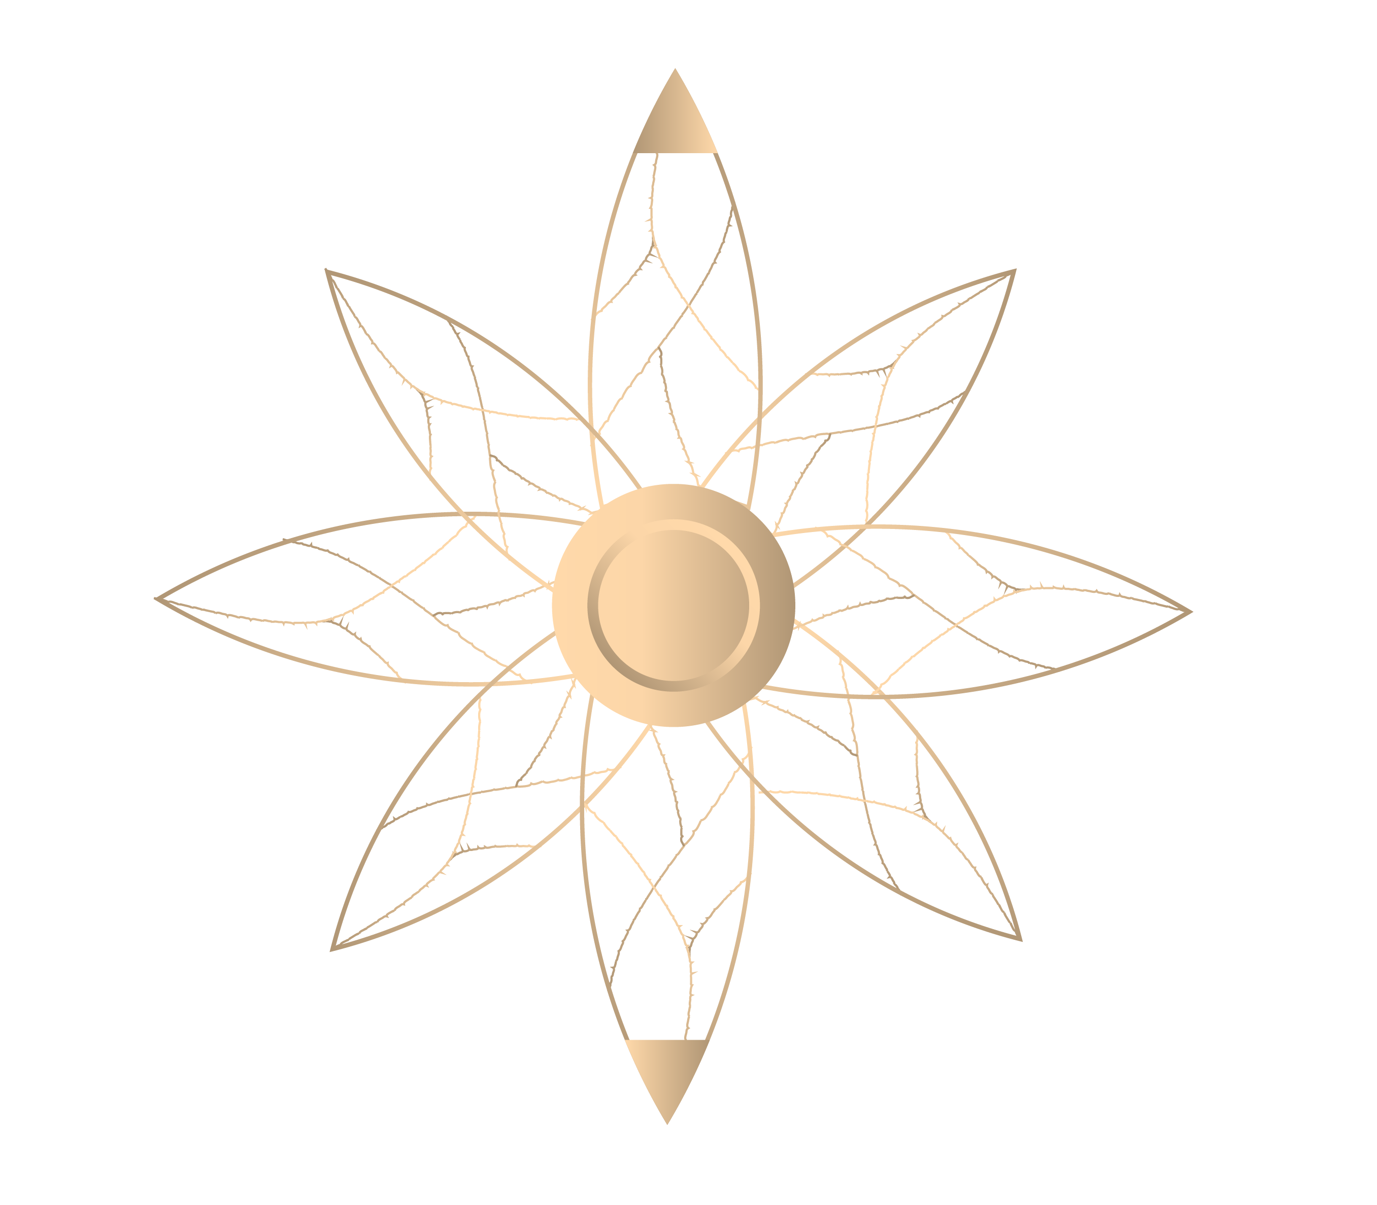
A sweet golden nectar
The Don Julio 1942 doesn’t just serve the best sweet nectar of agave but represents a way of life. One that indulges in splendor, exclusiveness, and an iconic lifestyle.
The kind that leaves a legacy behind.

Slide 9



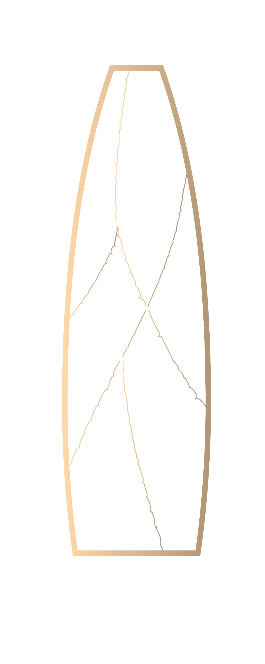
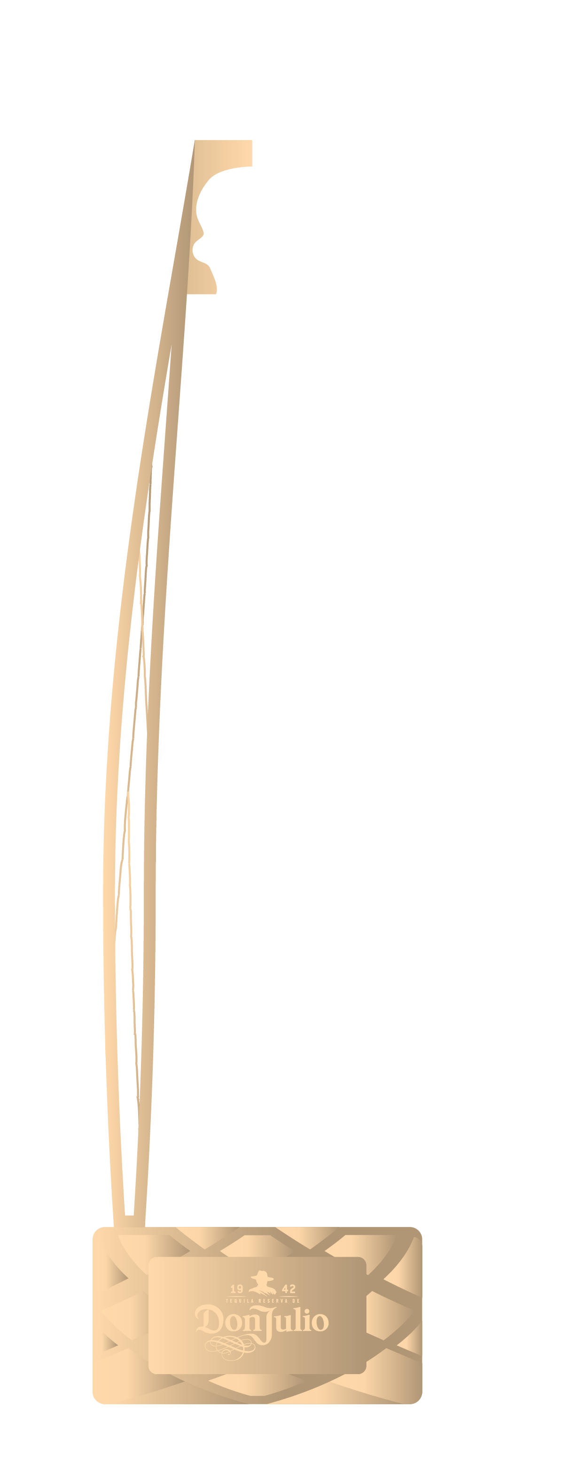
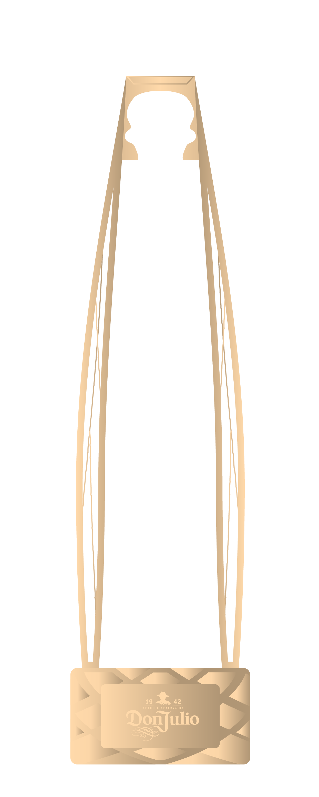
A sweet golden nectar
Don Julio 1942—the new status symbol for the elite.

Slide 10

Enter the world of Luxury

