Slide 1
S.HOW!
S M A R T E R T O G E T H E R

Slide 2
PROBLEM
Most of todays parents doesn’t understand the real role of the digital tools in their children everyday life. They don’t have enough knowledge about what type of apps they use, which platforms are important, how and why they use them.
This way they are not able to help them to learn how to handle these platforms on a responsible way and recognize the possible risks.
Let us Show.HOW Telekom can help them in this!

Slide 3
INSIGHT
Parents face varied challanges - and some of them not even existed when they where in the same age as their kids. While they are using the same devices and tools, adults might have the feeling, they are not talking the same language as the youngsters. It may seem, they are not even living in the same world - but its a fact that in the younger generations mind
There is one world and its Digital!
Both of them have to deal with the challanges of this and help to make the most out of it.
They have to learn to be a responsible user even in a young age - therefor their parents experience, support and knowledge might help.
To be a supportive parent in a long term they have to be an informed citizen of the Smart World too.

Slide 4
SOLUTION
USER GENENERATED CONTENT
MADE BY YOUNGSTERS
GAMIFICATION
FOR THE PARENTS
S.HOW EDUTAINMENT PROGRAM
FOR THE SOCIETY
+
=
Native user insights from the children by uploaded 60 sec short videos.
From the content of the children’s videos we create a webapp game for the adults.
We share the learnings in an integrated digital campaign.

Slide 5
THE CONTEST
Who else could give us a proper insight than a digital native child?
LOADS OF DIGITAL NATIVES, FOR SURE!
Telekom presents the content.S.HOW! competition for 10 -18 years old youngsters. The applicants have to upload a max 60 sec long video where they are talking about what do they do in their free time - online. This way we collect real insights what we use to create an edutaining game for adults.
BUT WHY WOULD THEY PARTICIPATE?
To win the ‘Smart Ambassador’ award which includes a package of: the smartest smart phone ever (the actual trending high-end mobile device) with 1 year unlimited data package and - based on the winners age- a selection of Telekom sponsored event tickets (eg. festivals, sport tournaments etc).

Slide 6
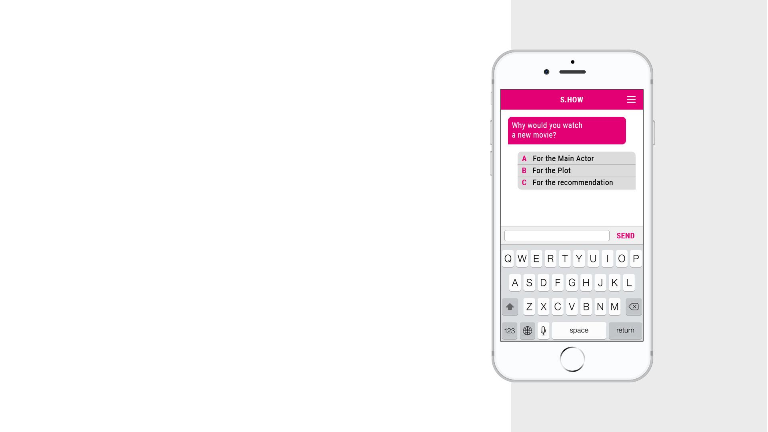
THE GAME
S.HOW us what you know!
Telekom presents the S.HOW Game for adults to let them show, how much they know about the digital world, apps and trends - and help them to learn about it too.
We create quiz questions by using the insights of the videos - with a small trick:
ORIGINAL SENTENCE OF A COMPETITOR TALKING ABOUT YOUTUBERS
“I watch new videos based of the recommendation of my friends and followchannels because of the creators / vloggers.”
LET’S CHECK THE TRANSFORMED QUESTION ON THE SCREEN!
And then we ask them to answer the original questions too.
WHO CAN GET THE PRICE?
The most enthusiastic chatter, who answers all of the real and transforms too! AND WHAT GETS THE WINNER? The same Smart Ambassador award and package as the best content creator gets - cause they are living in the same world, and it is digital.

Slide 7
WHAT HELPS US TO TRANSFORM THESE TO AN EDUCATION PROGRAM?
The way, how we use the content and data we get:
Collection of content.S.HOW! videos
we make the best ones available for the public
to help them understand the thinking of the youngsters
we use them as pre-rolls to promote the S.HOW game for the adults
Communication of the learnings
PR round-table discussions
digital school lessons for parents
Telekom Instagram and Facebook takeover with the SmartAmbassadors

Slide 8
THANKS FOR WATCHING!

