Slide 1
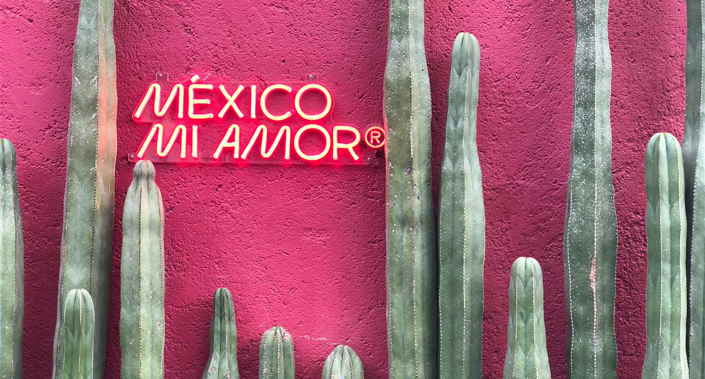
Digital brief
Young Cannes Lion

Slide 2
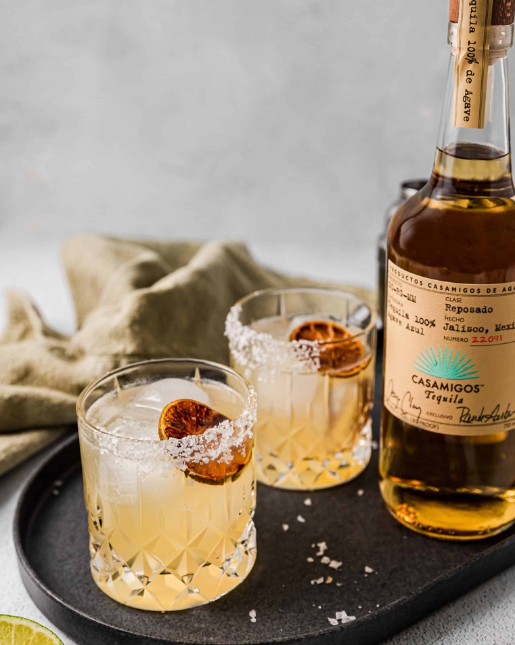
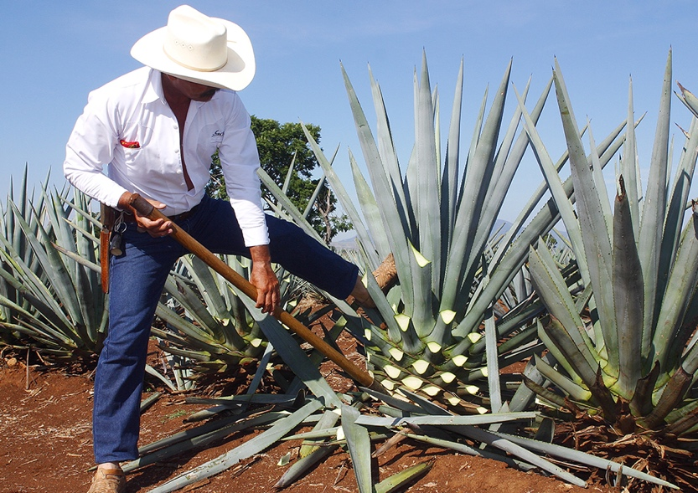
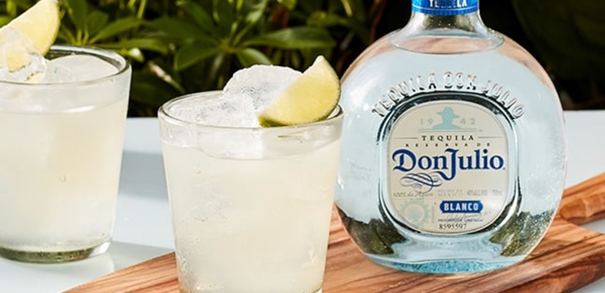
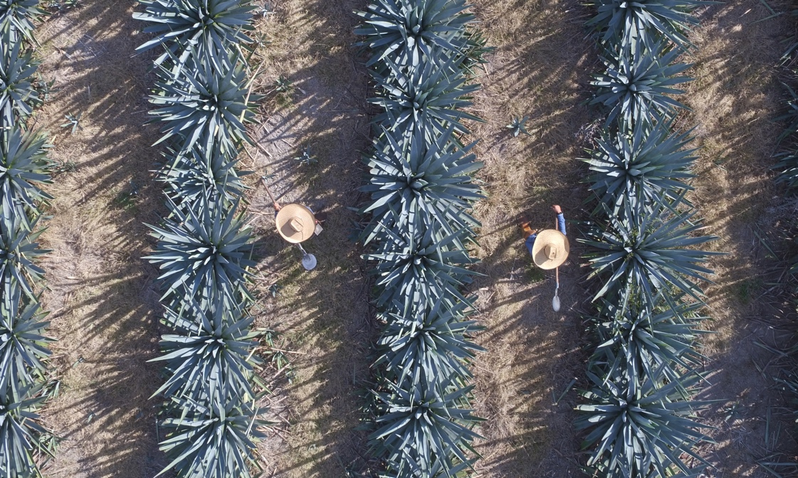
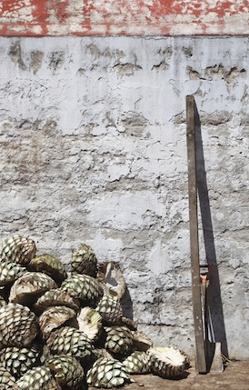
ABOUT TEQUILLA
ABOUT TEQUILA
What is Tequila?
Tequila is a distilled spirit made from (and only from) the blue Weber agave plant (or agave tequilana to give it its Latin name). It’s the plant’s heart – the piña ­– that holds the power.
And like with anything worth having, creating tequila takes time. It takes at least 6 years for the agave to get its perfect maturity, before the heart is harvested, cooked, then crushed and juiced; its juice is fermented with yeast and distilled to make tequila.

Slide 3
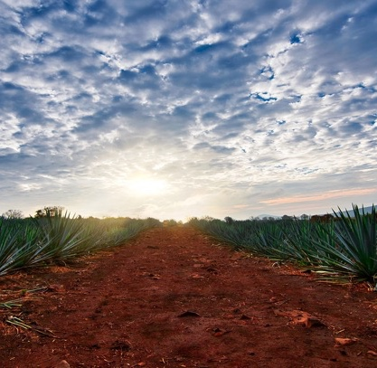
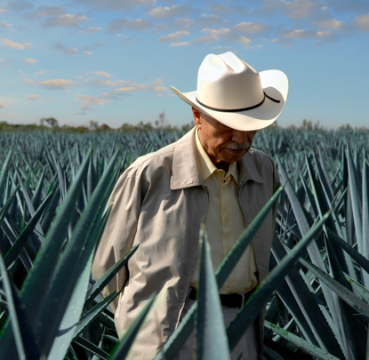
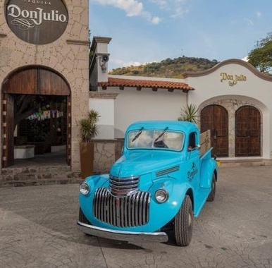
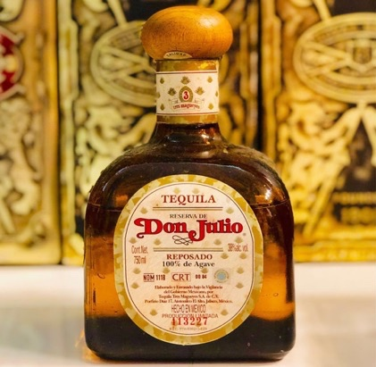
ABOUT TEQUILLA
ABOUT the brand
Who was Don Julio?
Julio Gonzalez was born on January 10. 1925, in Atotonilco, Jalisco. In 1942 he started a tequila distillery which would later be known as "La Primavera”.
In his relentless and obsessive quest of making exceptional tequila – one that would define the category and what the best tequila in Mexico should be – Julio Gonzalez had become Don Julio, a figurehead of tequila and an icon of Mexico. He spent nearly 45 years Improving his craft and In 1987, his Tequila was branded “Reserva de Don Julio” with the launch of Reposado.

Slide 4
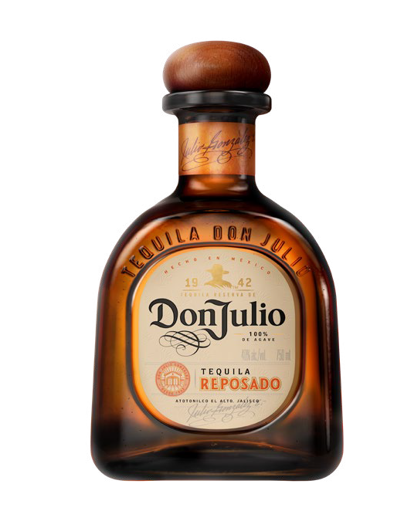
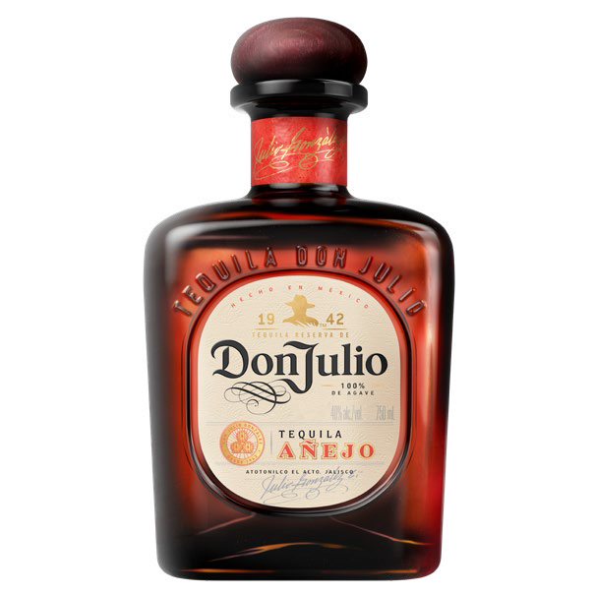
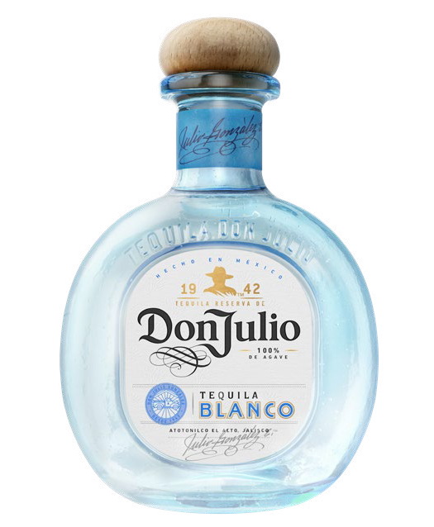
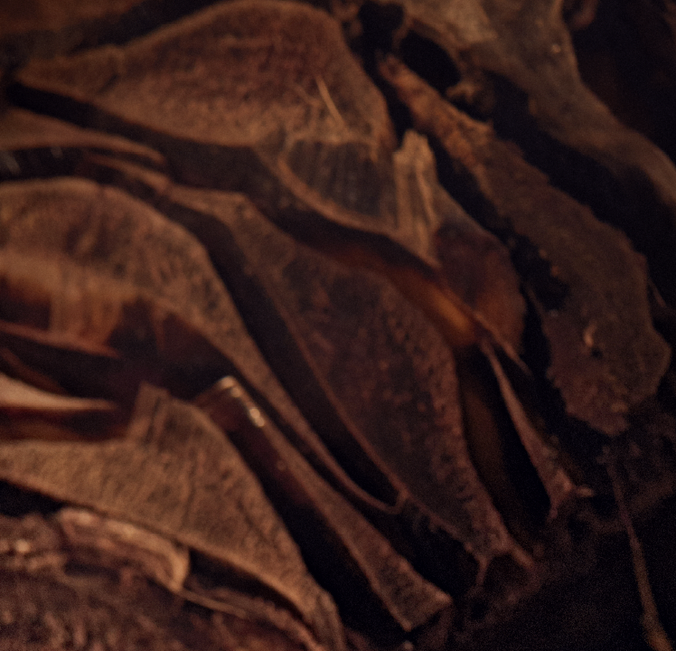
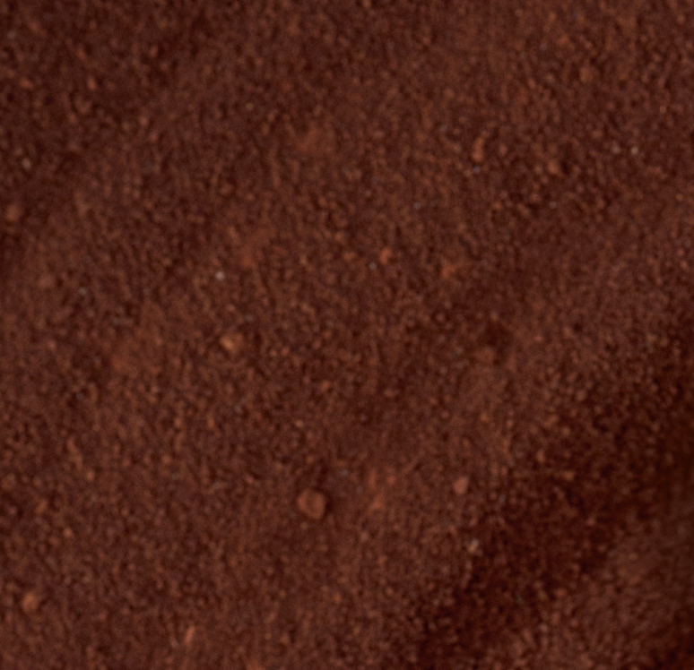
ABOUT THE BRAND
We have a category defining core portfolio of firsts
TEQUILA DE DON JULIO
100% DE AGAVE
REPOSADO
AÑEJO
BLANCO
1987
The world´s first luxury tequila, smooth and mellow aged for 8 months
1992
50th anniversary
Aged for 18 Months to get a rich and complex taste
1995
The Perfect Mixer – crips agave flavor with hints of citrus.

Slide 6
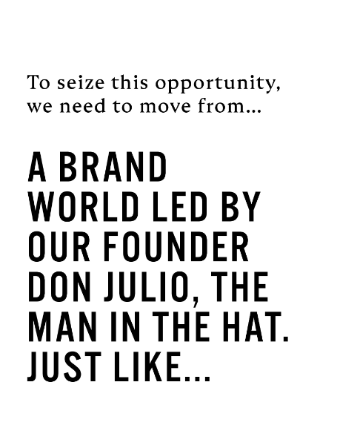
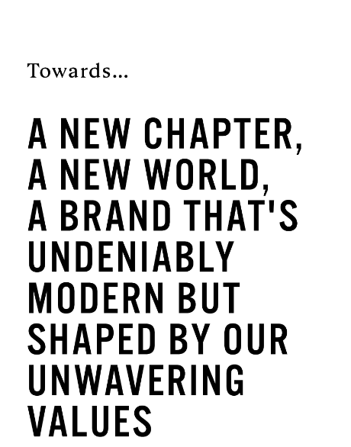

Slide 11
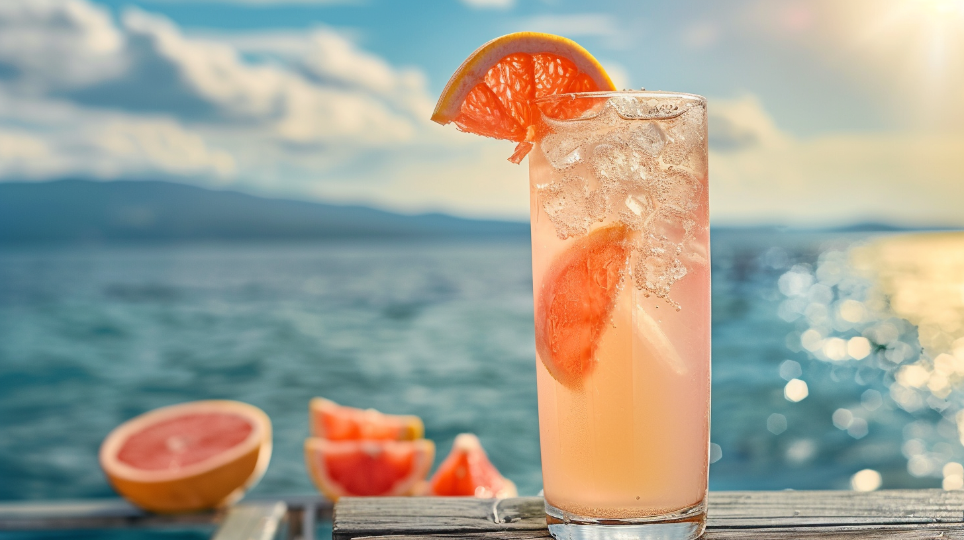
Don Julio Paloma
This refreshing, simple-to-serve drink is perfect for any celebration.
1.5 oz Tequila
1 oz Fresh Grapefruit Juice
0.5 oz Fresh Lime Juice
Splash Soda Water
Grapefruit Peel (Garnish)

Slide 12
BUILD FAME FOR DON JULIO PALOMA
CHALLENGE
Nobody thinks of tequila long drinks for their (summer) events, and they barely know what a Paloma is.
INSIGHT
Life is more fulfilling when you follow your heart over your head.
TARGET AUDIENCE
25-54 urban luxury consumers looking to celebrate and experience lively, upbeat occasions with friends.
OCCASSIONS
Momentous moments of celebration, especially upbeat occasions with a high tempo. We are trying to avoid laid- back moments.
TASK Create a bold digital activation that makes Don Julio Paloma the most sought-after drink for (summer) celebrations. An idea that fits seamlessly with Don Julio’s brand purpose and character, engages luxury consumers and drives trial.

Slide 13
Q&A

