Slide 1
Make moderation celebratory
Young Marketer brief

Slide 4
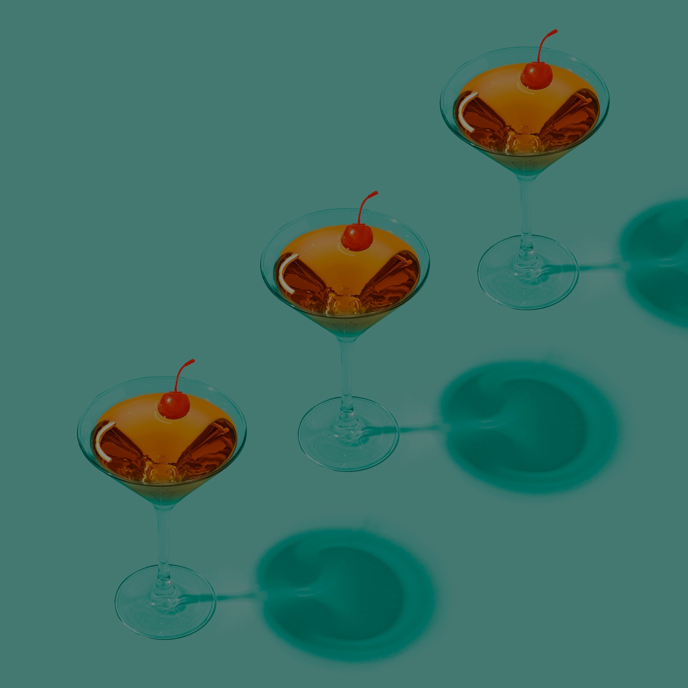
Diageo’s vision for Moderation
We want to change the way the world drinks for the better, celebrating moderation and continuing to address the harmful use of alcohol by changing attitudes and expanding our initiatives tackling underage drinking, drink driving and binge drinking.
Promoting moderation and addressing the harmful use of alcohol is not only the right thing to do – it is an essential part of our performance ambition.
Our commercial success depends on us creating a positive impact on society, wherever we live, work, source and sell. And, as a premium drinks company, we want people around the world who choose to drink alcohol to drink better, not more – and to trade up to our higher quality, better-tasting drinks.
Our brands have been part of people’s celebrations for generations. We make them with pride – and they are made to be enjoyed responsibly.

Slide 5
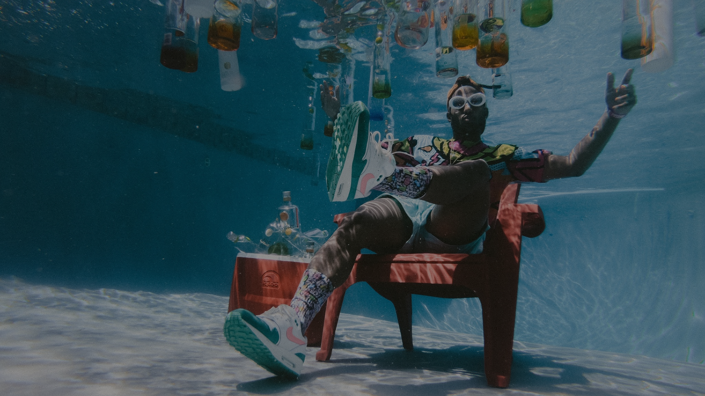
The challenge
The narrative around drinking responsibly is often depicted as dark, halting the good times and fun vibes - especially for young people.
If some of them is seen “nursing” their drink, they are frequently portrayed as uninteresting or dull.

Slide 6
Brands in focus

Slide 7
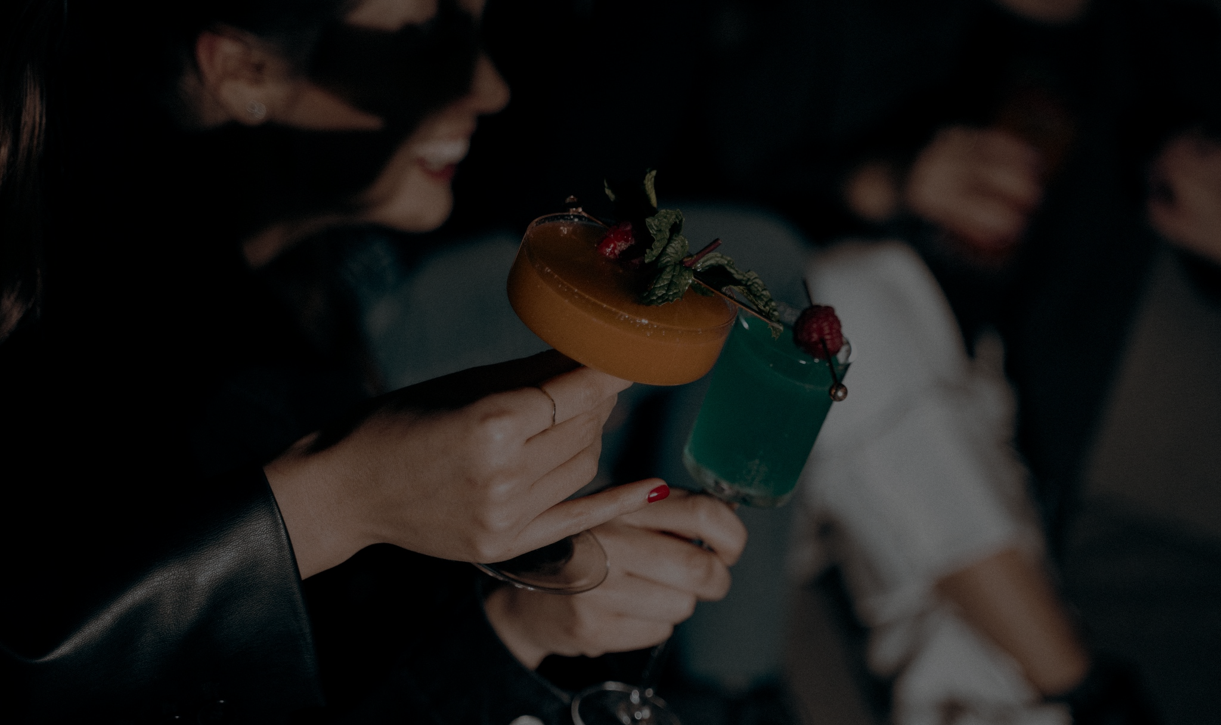
Make moderation cool again from now on
The task: identify a marketing comms territory that reframes and celebrates what it means to drink with moderation in a client brief format (max. 2 page word doc)
Campaign goal: shift existing social norms around drinking, and support Diageo’s ambition to reach one billion people globally with a targeted message of moderation by 2030.
You can focus on one of the highlighted brands or come up with an idea for Diageo as a company.
Non-alc variants can be part of the idea, but it shouldn’t be a promo campaign for non-alc variants.
Target audience: 18-24s in Hungary, who are socializing actively
Channels: social media, digital, outdoor, ambient, festivals, activations
Timing: 2023 summer

Slide 8
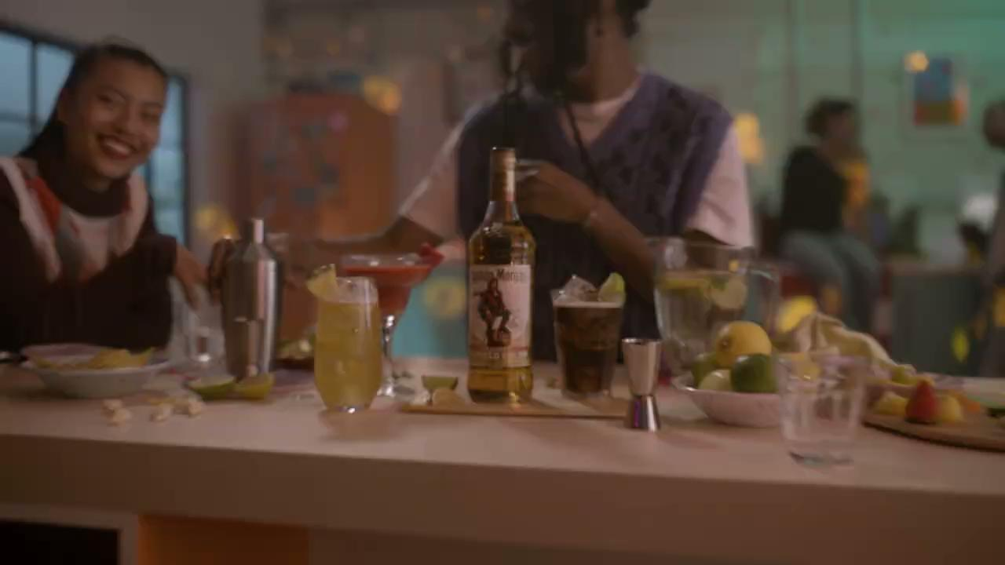
Notes:
https://drive.google.com/file/d/1DxpW7JLyevQfh8679DnN4_CSeD4LACnQ/view?usp=sharing

