Slide 1
sada
YOUNG CANNES LIONS
🎂💗

Slide 2
From 🙄 to 😍
McDonald's is opening more and more restaurants across the country, requiring a growing workforce.
Young people want to find their first job, but often almost 1-2 years of work experience is required.
However, they are full of references, just not necessarily on their CVs.
We need to show them how easily they can get the first job without experience in a fun, attention grabbing way.
So that they'll be excited to apply for Meki.
Thus every restaurant in the country should be full of staff.

Slide 3
🔍 Insight 🔍
Most companies need previous work experience to hire anyone.
However, new jobseekers don't have a previous boss to write a professional reference for them.
But these career starters have relatives who are more than willing to do so.

Slide 4
💡Idea💡
You know the Hungarian saying for nepo babies that it was only difficult for them to be born. (,,Neki is csak megszületnie volt nehéz.”) Well, at Meki, this is true for the newcomers, as they don't need any previous work experience or references to start their career in the industry.
But they do need one reference. From their mom. 💁‍♀️ From their bff. 👯‍♀️ From their granny. 👵🏻

Slide 5
We believe…
…in moms, friends, and grandparents who are brave enough to tell the whole world: they are proud of you.

Slide 6
In our campaign, we will create a BB series of real, supportive comments from social media to amplify our message:
One positive comment is enough for us to give you your first work experience. There is no need for 1-2 years of experience.

Slide 7
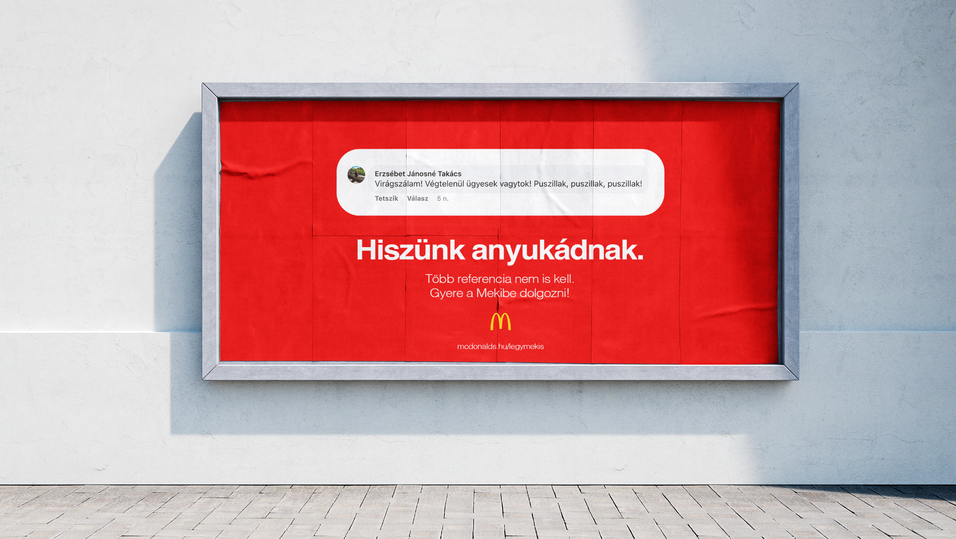
We believe your mom. No more references needed.
Come to work at the meki.

Slide 8
We believe your mom. No more references needed.
Come to work at the meki.
We believe your bff. No more references needed.
Come to work at the meki.
We believe your granny. No more references needed.
Come to work at the meki.

Slide 9
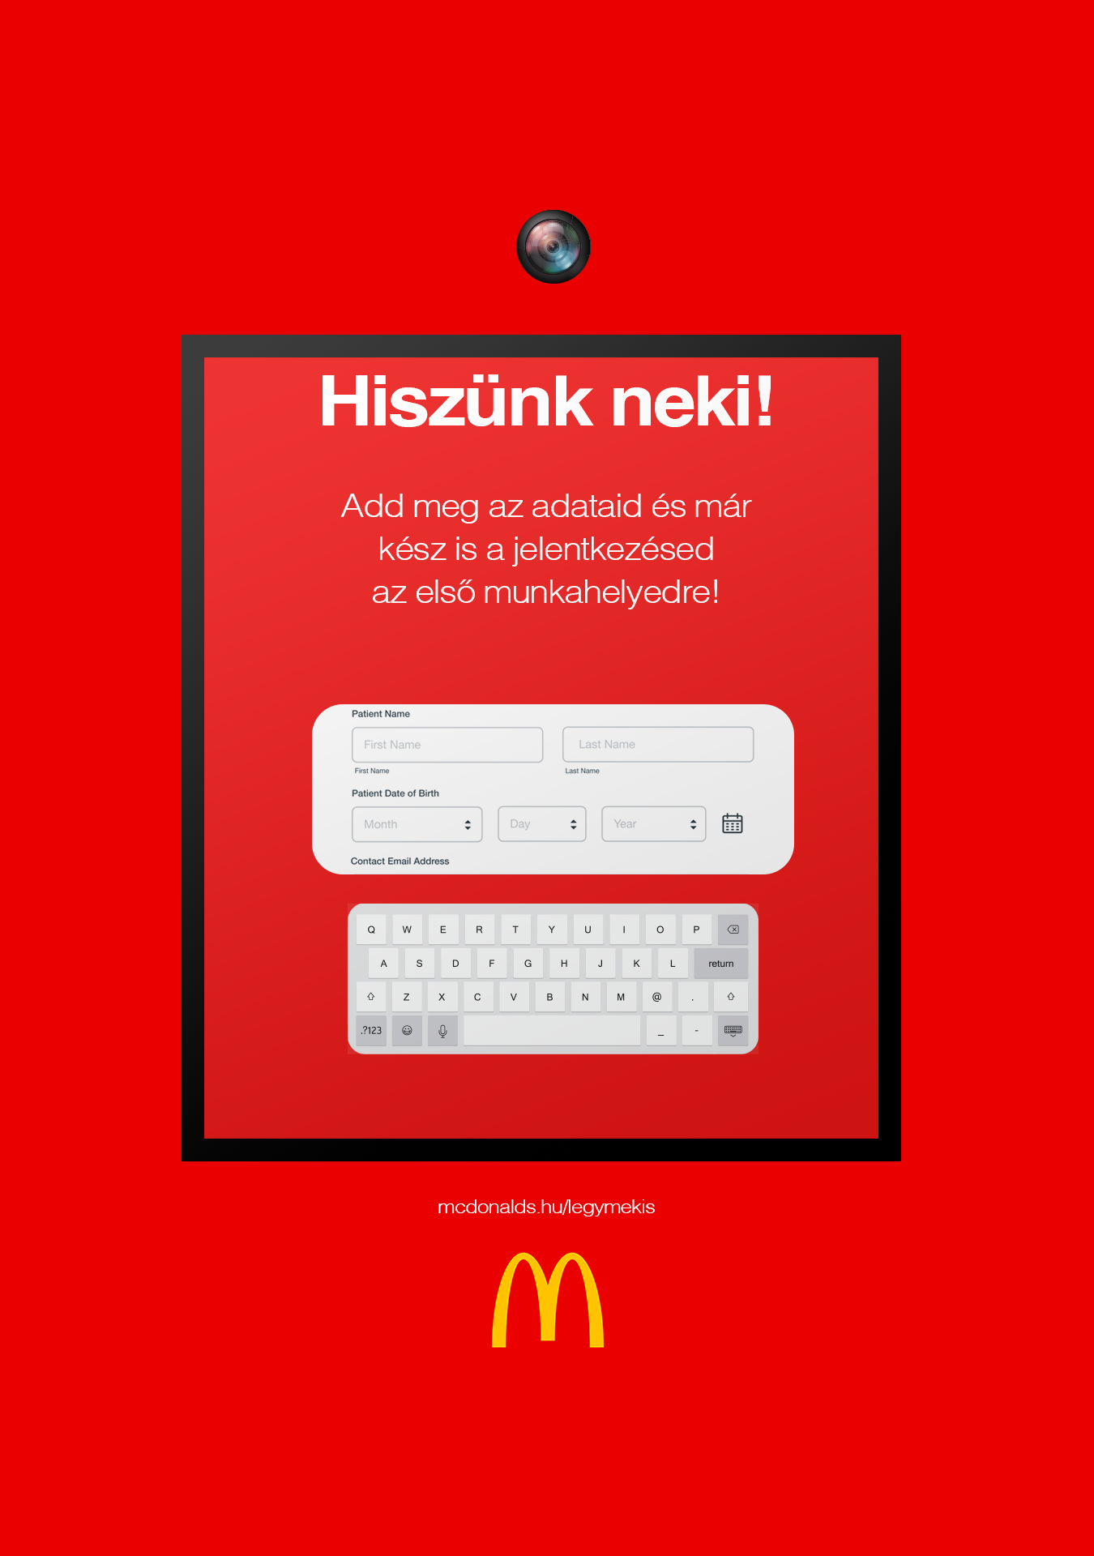
We believe! Enter your details and you're ready to apply for your first job.
Do you already have a positive comment?
Cool. 🔥
We have some DLPs where you can apply instantly!
Just show up with your phone and point your comment into the camera on top of the DLP.
The AI will detect the tone of the text and approve the recommendation.
You can then fill out an application for your first job
at Meki.

Slide 10
We encourage young people to tag McDonald's profile below the positive comments they've already received and reach out their relatives to create new proud suggestions.
HR staff will contact them based on social listening.

