Slide 1
Hi Hajnal Bíborka,
Elek Tricity wants to be friends with you.

Slide 2
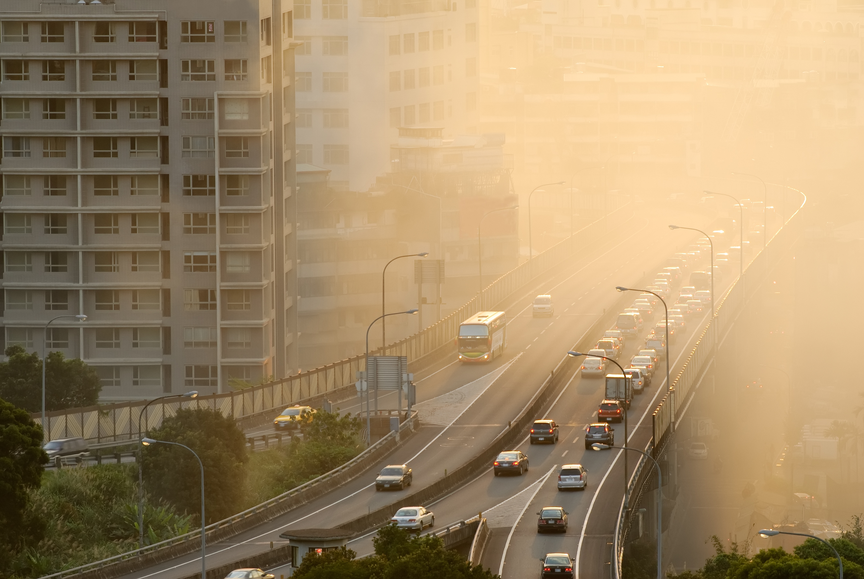
WINTER CLIMATE CHANGE IS COMING
Climate change and air pollution is a huge problem accross the world and especially in big cities. Electric transportation can be a solution to this but it is not widespread yet:
Older generation is hard to convince -> old habits die hard
Niche – hard to connect a wider group
Need to think big

Slide 3
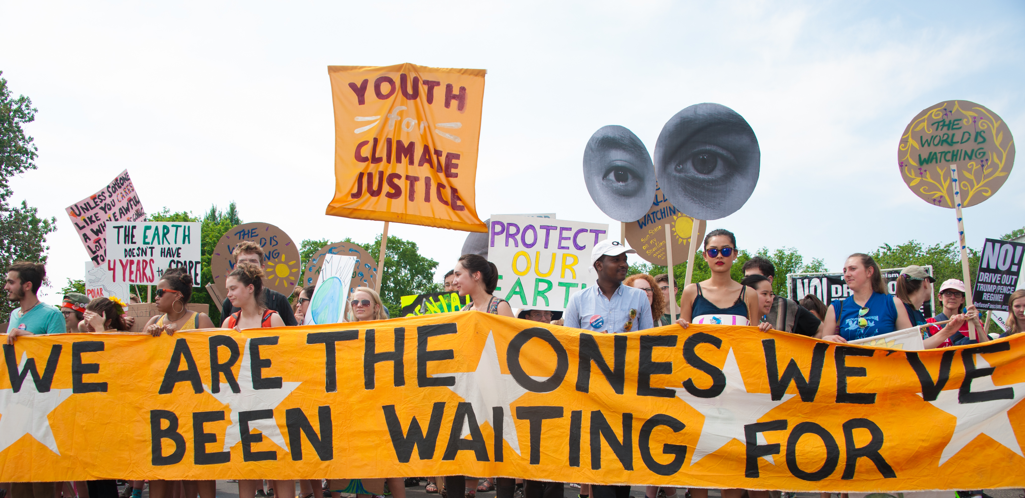
ONE GENERATION TO THE RESCUE
CHALLENGE
Motivate Gen Z to become the brand ambassador of e-mobility
Connect E-ON with TA on a personal level
INSIGHT
Environment protection is one of the biggest hype nowadays and GenZ is ready to ride along with it.
Notes:
How to strengthen e-mobility, through changing the attitude of genZ and parallel making a strong impact on elder generations.
How to motivate genZ in order to become ambassadors of e-mobility, motivating their environment to make concious decisionmaking.

Slide 4
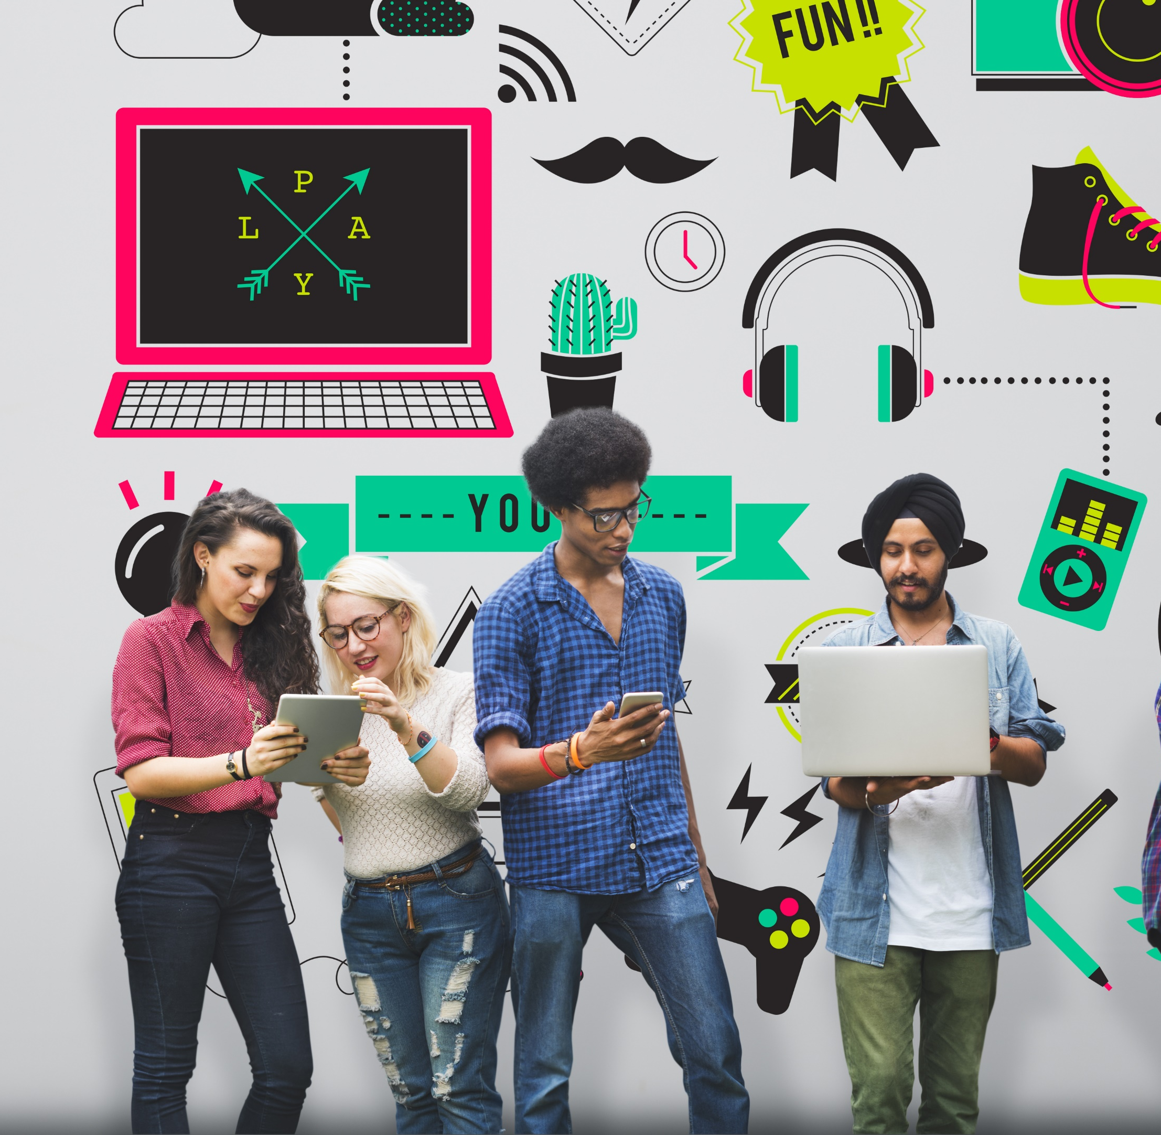
WHO ARE GENZ?
GenZ is motivated, ready to act
They are seeking for recognition
Willing to step in the spotlight online
Isolated but they socialize online
Consciousness is key and they expect their brands to be authentic
Eager to meet inner and outer expectations

Slide 5
A PARTNERSHIP IS FORMING
Personalize electricity to engage with Gen Z so they can be part of saving the world one step at a time with E-ON as their partner.

Slide 6
MEET ELEK - your friend in saving the world
Everybody wants to be friends with Elek, because his friendship means you are devoted in saving the environment.
He is seeking for quality friendships but raising his attention is a challenge.
Elek Tricity

Slide 7
SNEAK-PEAK OF ELEK’S PERSONAL DIARY
1. In the first few weeks, I’m seeking for friends – by showing my existance on relevant platforms, rise youngsters attention that I am open for any conversation (especially about how to save the environment).
2. After my introduction, young people will be able to connect useful electric solutions with me, and I hope they are nice enough to write personal, funny stories to me about how happy they are.
Hey, I’m getting to know new people every day!
3. I think at this point I will contact them, since they were so nice sharing their story. Being friends we can show that we care about the world and our common future by helping each other.
4. I know being a friend is sometimes not enough – I really hope I can meet their families and deepen our relationship. I hope their parents will like me as well.

Slide 8
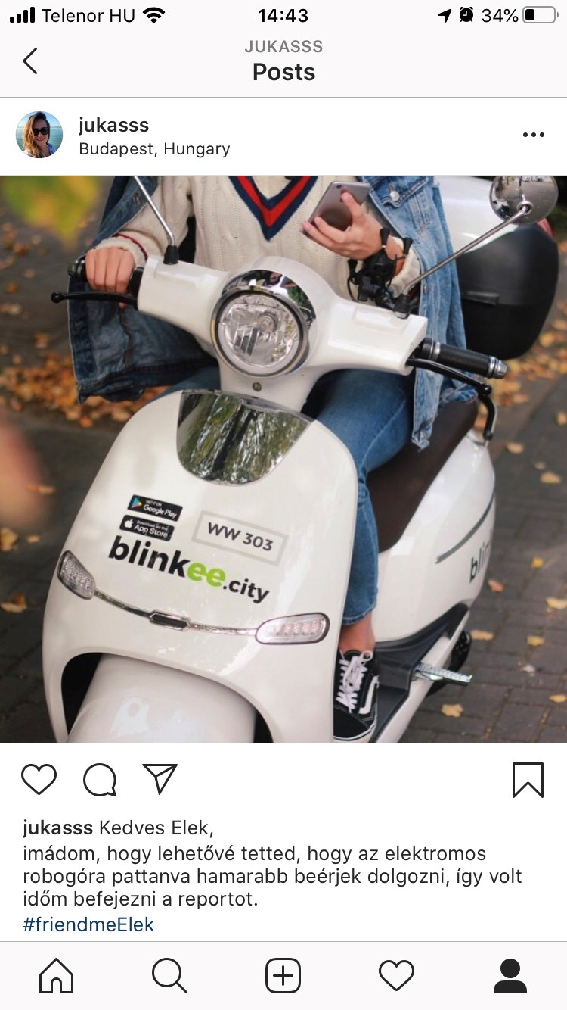
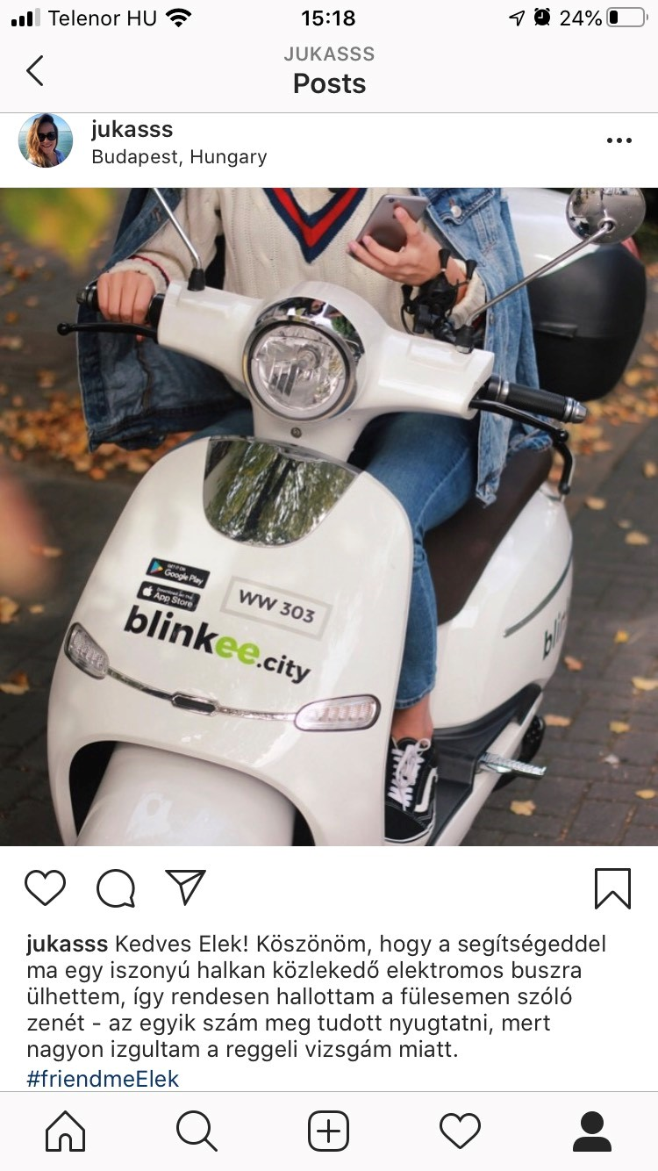
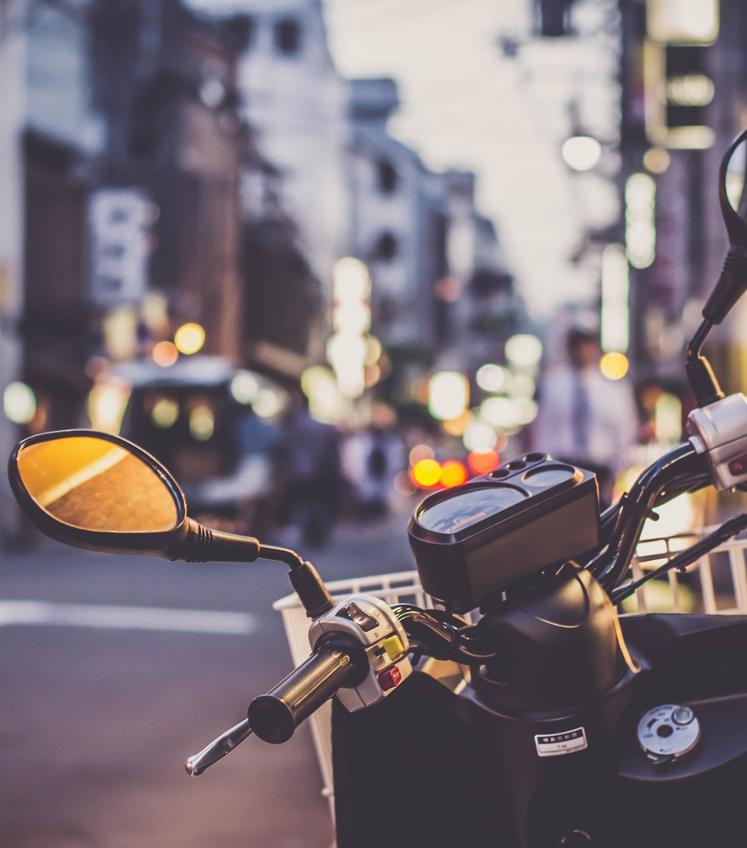
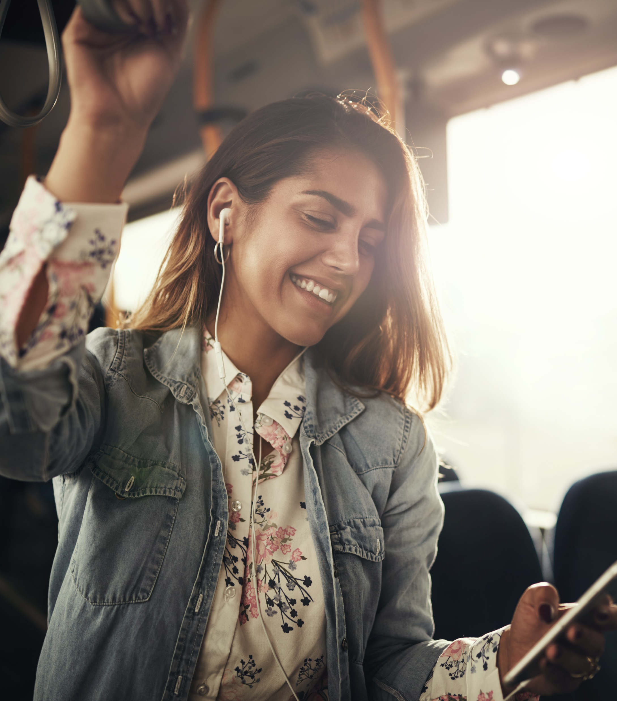
ELEK LISTENS TO YOU
GIZI_01
GONATURE_2
LOVEMYWORLD_2
Youngsters addressing Elek by sharing their stories of how e-mobility helped their life.
By tagging posts with #friendmeElek, Elek Tricity will see their content and will be able to respond by friending them on social media platforms.
Having Elek as a friend is a prestige amongst young people, representing their beliefs and acts, leading an environmental friendly lifestyle.
Every second week, Elek chooses a Best Friend, whom with‚ he will go home and can be introduced to the winner’s parents.
GIZI_01
GONATURE_2
LOVEMYWORLD_2

Slide 9
SEEKING FOR FRIENDS
In order to build awareness at the first stage of the campaign amongst TA, we need to reach them on their frequently used platforms with creative, attention grabbing solutions.
Digital citylight
Raise awareness with #bemyfriendElek message.
Catch Gen Z on their way
Tiktok video & OLV
Personalized platform for GenZ
Spotify
Sponsored sessions by E-ON
Playlist with songs in connection with electricity
(MGMT- Electric feel)
Do you want to be friends?

Slide 10
FOR A CLEANAIR FUTURE
By 2025, majority of people will realize through youngsters that stopping climate change requires steps by each part of the process.
Decreasing air pollution is one of that steps, and realising that electricity is our friend, we can move forward together as one big family for a cleaner future.

